Slide 1
Programming OpenFlow Flows for Scientific Profit
Azher Mughal / Beraldo Leal
SuperComputing 2015

Slide 2
http://supercomputing.caltech.edu/
7 Booth Connections
2 WAN Connections
Single OpenFlow Controller (OpenDaylight)
Global Topology View
OpenFlow interconnected Islands
Primarily composed of Dell OpenFlow Z9100 100GE switches
Also in use are switches from Brocade, Mellanox and Inventec
3

Slide 3
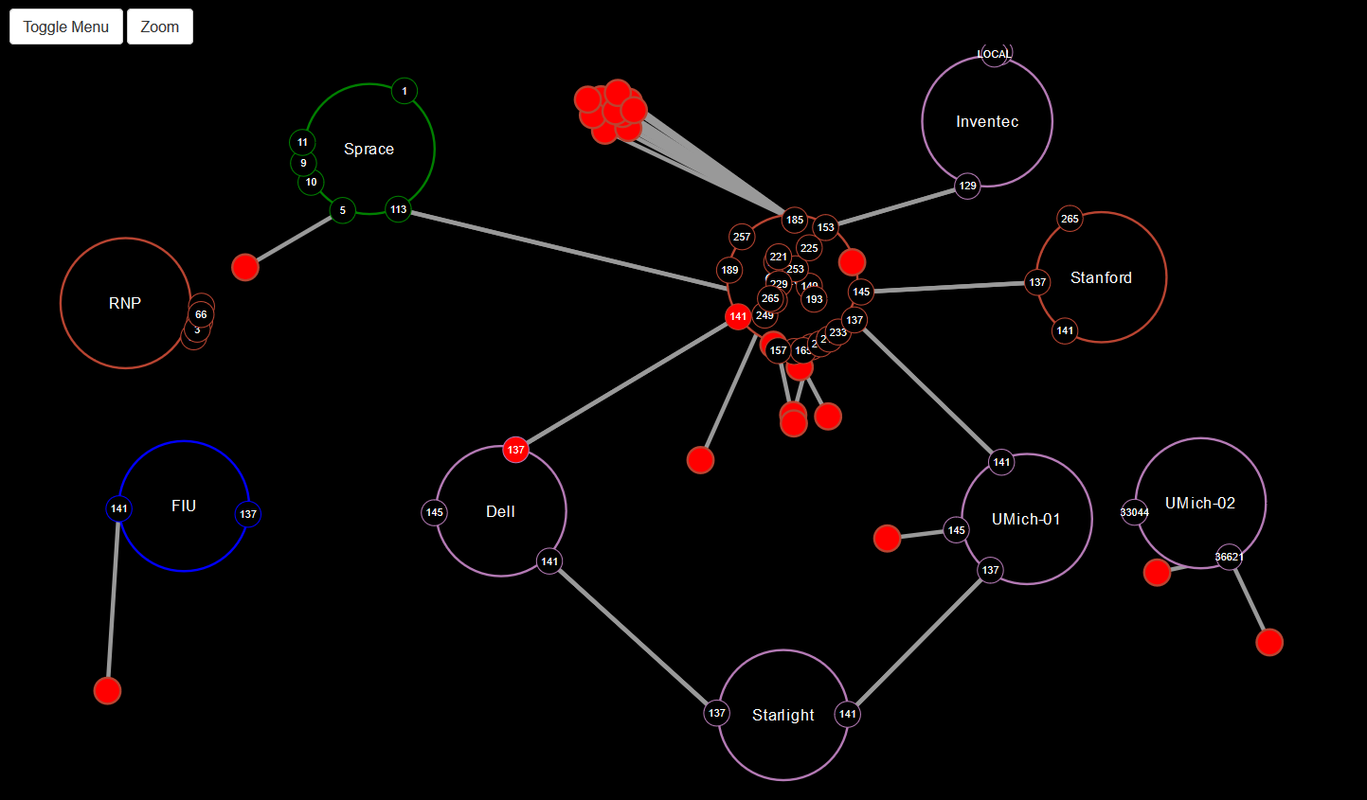
SDN Topology (Show Floor and Remote Islands)

Slide 4
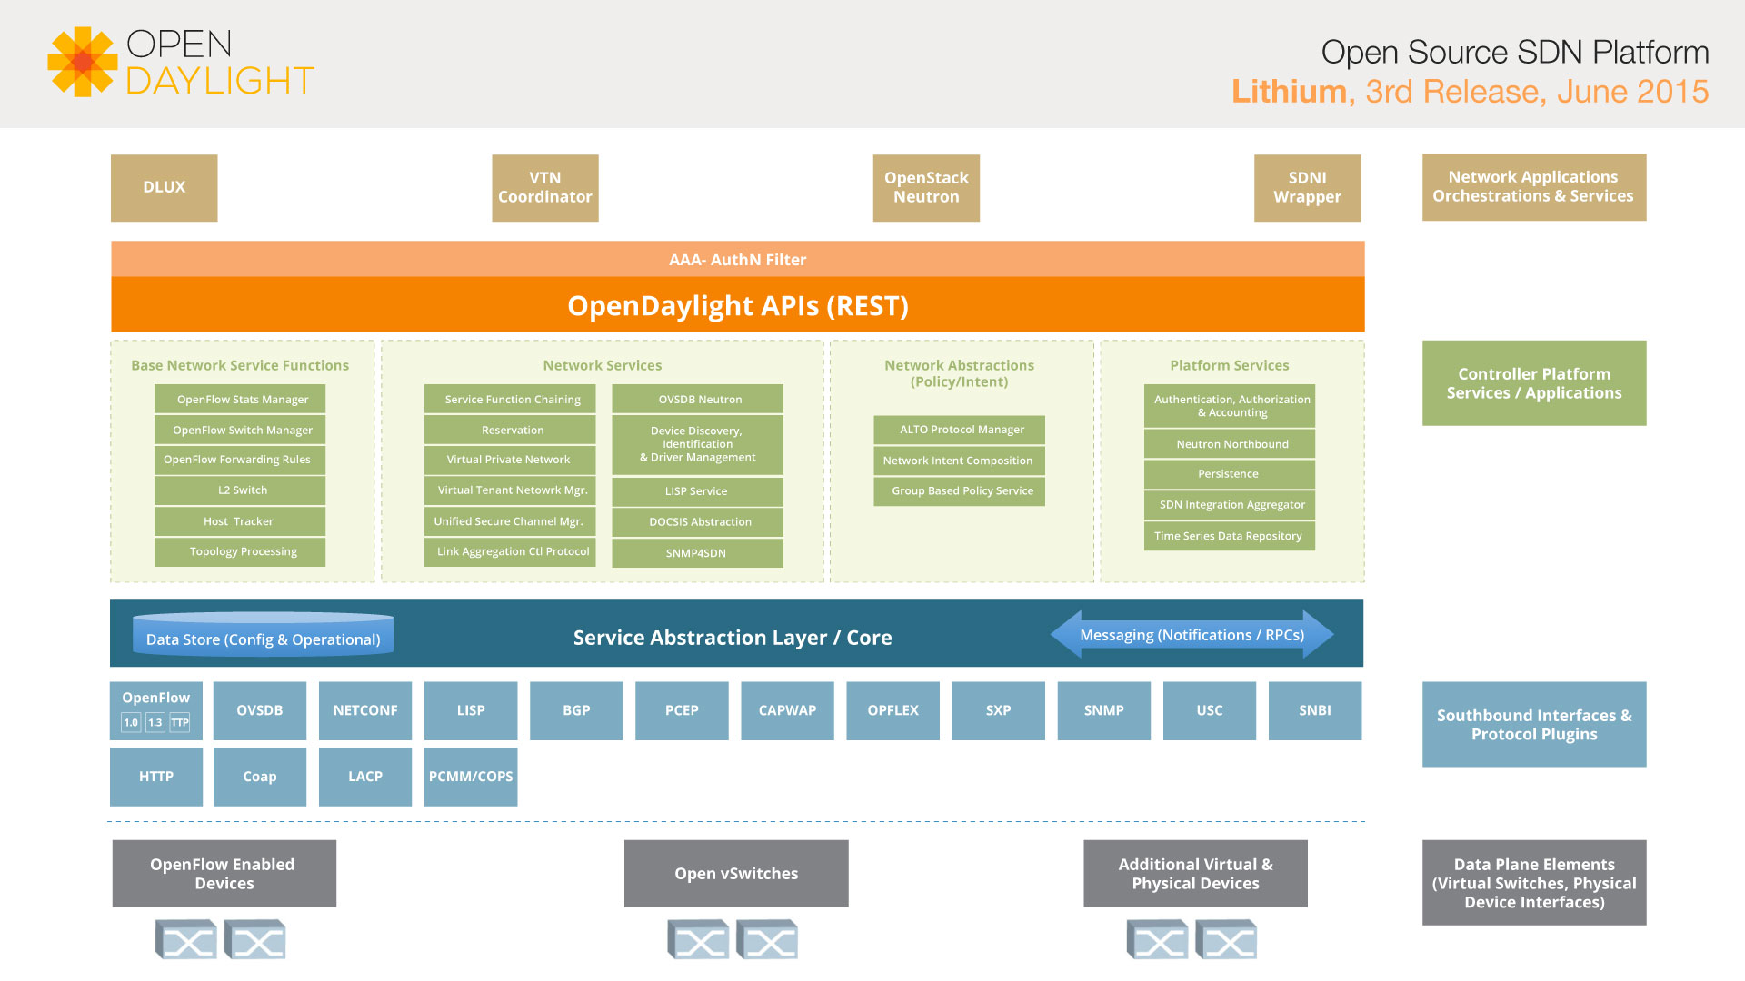
OpenDaylight Lithium Components

Slide 5
OpenDaylight Controller
Software Components:
NETCONF: An IETF device configuration management protocol
Yang Model: Yet Another Next Generation” (YANG) data modeling language for the NETCONF protocol
MD-SAL: Model Driven Service Abstraction Layer
  State and Data representation is done through models (YANG)
  Model agnostic. Not limited to just flow supporting devices (Cisco, Juniper, Brocade all are offering YANG modules for their configuration)
  Multiple data stores (e.g. Config / Operational)
AD-SAL: API Driven Service Abstraction Layer
  1:1 mapping between NorthBound and SouthBound
http://sdntutorials.com/difference-between-ad-sal-and-md-sal/

Slide 6
NorthBound vs SouthBound Functionality
Application communicates using the NorthBound RESTCONF with the Controller (install/delete/query controller)
SouthBound (plugins) talks with the devices and push the configuration
NorthBound Plugins
(e.g. RESTconf and NETCONF)
SDN Controller
SouthBound Plugins
(e.g. OpenFlow plugin)
Packet Forwarding Devices
Beraldo Leal /

Slide 7
Python ODL Library
Python Library Download for the OpenDaylight Lithium Release
http://supercomputing.caltech.edu

Slide 8
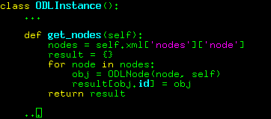
Python: XML
Get nodes list: XML to Python Object)

Slide 9
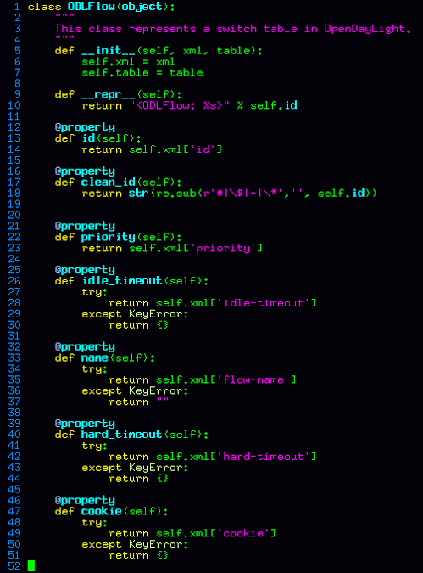
Python Flow Class:
XML attributes specific to ODL, converted to Python attributes

Slide 10
Questions:
azher@ hep.Caltech.edu
beraldo@ncc.unesp.br

