Slide 1
PANDA: Networking Update
Kaushik De
Univ. of Texas at Arlington
SC15 Demo November 18, 2015

Slide 2
Overview
PanDA workload management system was developed for the ATLAS experiment at the Large Hadron Collider
Hundreds of petabytes of data per year, thousands of users worldwide, many dozens of complex applications…
Leading to ~500 scientific publications
Discovery of the Higgs boson, search for dark matter…
A new approach to distributed computing
A huge hierarchy of computing centers working together
Main challenge – how to provide efficient automated performance
Auxiliary challenge – make resources easily accessible to all users
Network Aware Data Management is crucial for systems like PanDA to work efficiently

Slide 3
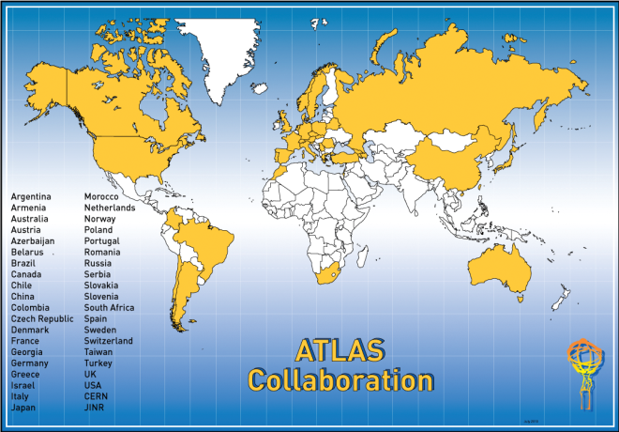
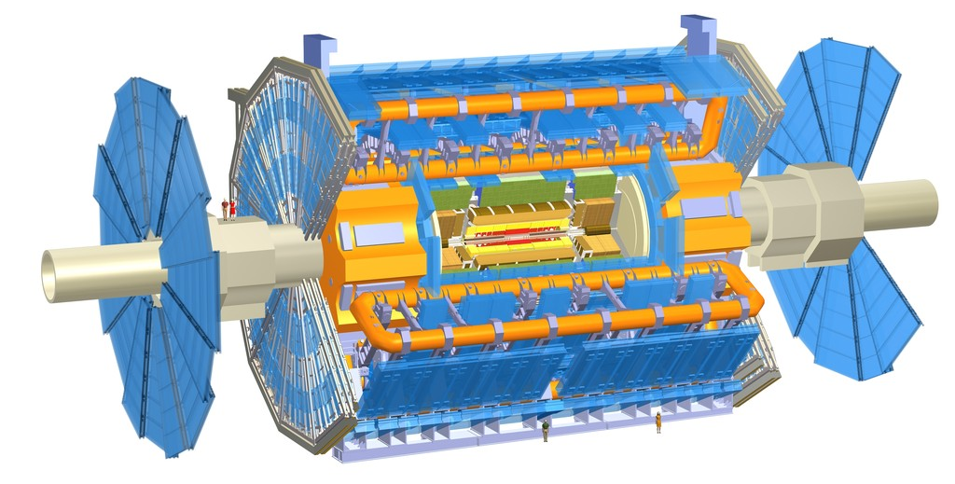
The ATLAS Experiment at the LHC
Largest data sensor in the world

Slide 4
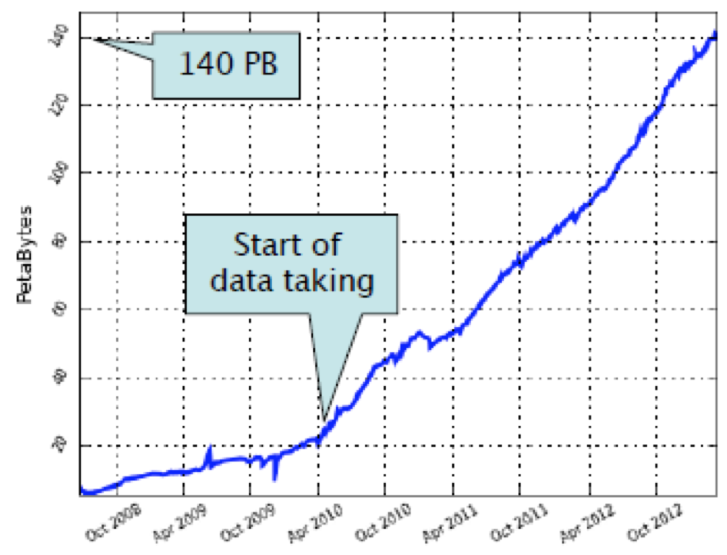
ATLAS is Big Data
Lib of
Congress
Business emails sent
3000PB/year
(Not managed as
a coherent data set)
ATLAS
data
Big Data in 2013
Climate
DB
Facebook uploads
180PB/year
Current ATLAS data set, all data products: 160 PB
1+M files transferred per day
LHC data
15PB/yr
Google search
100PB
Nasdaq
YouTube
15PB/yr
US
Census
Kaiser
Permanente
30PB
Wired 4/2013
http://www.wired.com/magazine/2013/04/bigdata/
Notes:
http://www.wired.com/magazine/2013/04/bigdata/

Slide 5
Distributed Computing in ATLAS
Workload Managemeent
System

Slide 6
Paradigm Shift in HEP Computing
New Ideas from PanDA
Distributed resources are seamlessly integrated
All users have access to resources worldwide through a single submission system
Uniform fair share, priorities and policies allow efficient management of resources
Automation, error handling, and other features in PanDA improve user experience
All users have access to same resources
Old HEP paradigm
Distributed resources are independent entities
Groups of users utilize specific resources (whether locally or remotely)
Fair shares, priorities and policies are managed locally, for each resource
Uneven user experience at different sites, based on local support and experience
Privileged users have access to special resources

Slide 7
PanDA Scale
Current scale – 35M jobs completed every month at >hundred sites
First exascale system in HEP – 1.2 Exabytes processed in 2013

Slide 8
CPU Consumption
During LHC Run 1+2, per month, aggregated by federation

Slide 9
The Growing PanDA EcoSystem
ATLAS PanDA core
US ATLAS, CERN, UK, DE, ND, CA, Russia, OSG …
ASCR/HEP BigPanDA
DoE funded project at BNL, UTA – PanDA beyond HEP, at LCF
CC-NIE ANSE PanDA
NSF funded network project - CalTech, Michigan, Vanderbilt, UTA
HPC and Cloud PanDA – very active
Taiwan PanDA – AMS and other communities
Russian NRC KI PanDA, JINR PanDA – ATLAS, COMPASS, ALICE, NICA, Biology…
AliEn PanDA, LSST PanDA, other experiments

Slide 10
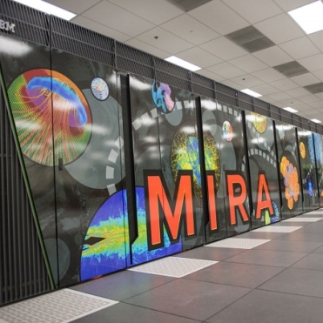
Resources Accessible via PanDA
Many
Others
About 200,000 job slots used continuously 24x7x365

Slide 11
PanDA References
PanDA – Production and Distributed Analysis System
Deployed on WLCG infrastructure
Standards based implementation
REST framework – HTTP/S
Oracle or MySQL backends
CondorG based pilot factories
Python packages available from SVN and GitHub
Command-line and GUI/Web interfaces
Reference
https://twiki.cern.ch/twiki/bin/view/PanDA/PanDA
http://pandawms.org/

Slide 12
PanDA Networking Projects
DOE ASCR and HEP funded project “Next Generation Workload Management and Analysis System for Big Data”
Generalization of PanDA for HEP and other data-intensive sciences
Project participants from ANL, BNL, UT Arlington
WP3 (Leveraging intelligent networks): Integrating network services and real-time data access to the PanDA workflow
ANSE project – funded by NSF CC*NIE
CalTech, Michigan, Vanderbilt, UT Arlington
Advanced Network Services for Experiments

Slide 13
WP3 PanDA and Networking
PanDA as workload manager
PanDA automatically chooses job execution site
Multi-level decision tree – task brokerage, job brokerage, dispatcher
Also predictive workflows – like PD2P (PanDA Dynamic Data Placement)
Site selection is based on processing and storage requirements
Why not use network information in this decision?
Can we go even further – network provisioning?
Network knowledge useful for all phases of job cycle
Network as resource
Optimal site selection should take network capability into account
We do this already – but indirectly using job completion metrics
Network as a resource should be managed (i.e. provisioning)
We also do this crudely – mostly through timeouts, self throttling
Goal for PanDA
Direct integration of networking with PanDA workflow – never attempted before for large scale automated WMS systems

Slide 14
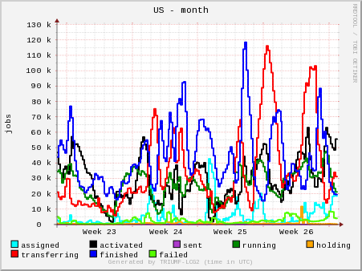
Job Workflow
Panda jobs go through a succession of steps tracked in central DB
Defined
Waiting
Assigned
Throttled
Activated
Sent
Starting
Running
Holding
Transferring
Finished/failed
Cancelled

Slide 15
Using Network Information
Pick a few use cases
Cases which are important to PanDA users
Enhance workload management through use of network
Case 1: Improve User Analysis workflow
Case 2: Improve Tier 1 to Tier 2 workflow
Step by step approach
Collect network information
Storage and access
Using network information
Using dynamic circuits

Slide 16
Sources of Network Information
DDM Sonar measurements
Actual transfer rates for files between all sites (Tier 1 and Tier 2)
This information is normally used for site white/blacklisting
Measurements available for small, medium, and large files
perfSonar (PS) measurements
perfSonar provides dedicated network monitoring data
All WLCG sites are being instrumented with PS boxes
US sites are already instrumented and monitored
Federated XRootD (FAX) measurements
Read-time of remote files are measured for pairs of sites
This is not an exclusive list – just a starting point

Slide 17
Network Data Repositories
Native data repositories
Historical data stored from collectors
SSB – site status board for sonar and perfSonar data
FAX data is kept independently and uploaded
AGIS (ATLAS Grid Information System)
Most recent / processed data only – updated periodically
Mixture of push/pull – depending on source of data
schedConfigDB
Internal Oracle DB used by PanDA for fast access
Uses standard ATLAS collector

Slide 19
Case 1: Faster User analysis
First use case for network integration with PanDA
Goal - reduce waiting time for user jobs
User analysis jobs normally go to sites with local input data
This can occasionally lead to long wait times (jobs are re-brokered if possible, or PD2P data caching will make more copies eventually to reduce congestion)
While nearby sites with good network access may be idle
Brokerage uses concept of ‘nearby’ sites
Use cost metric generated with Hammercloud tests
Calculate weight based on usual brokerage criteria (availability of CPU resources, data location, release…) plus new network transfer cost
Jobs will be sent to the site with best overall weight
Throttling is used to manage load on network

Slide 21
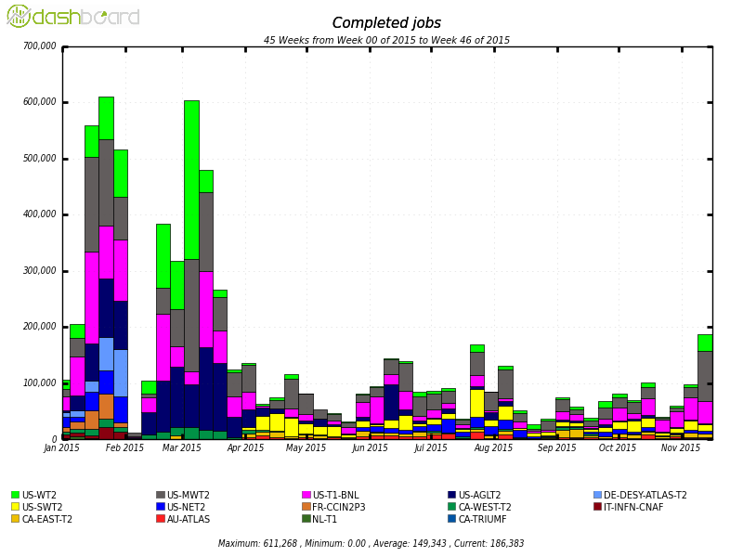
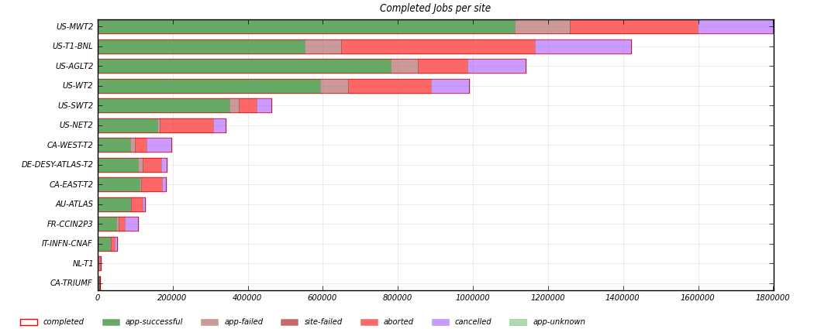
Measure of Success
Many sites used for overflow
Failure rate is manageable

Slide 22
First Tests
Tested in production for ~1 day in March, 2014
Useful for debugging and tuning direct access infrastructure
We got first results on network aware brokerage
Job distribution
4748 jobs from 20 user tasks which required data from congested U.S. Tier 1 site were automatically brokered to U.S. Tier 1/2 sites

Slide 23
Brokerage Results

Slide 24
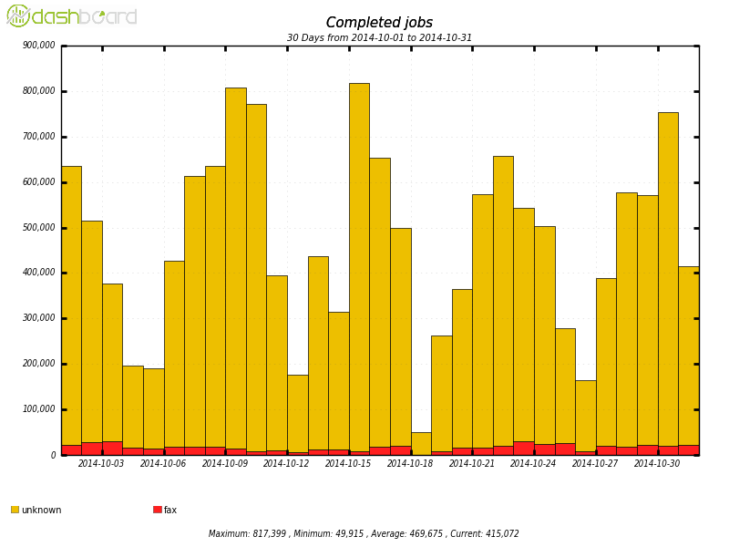
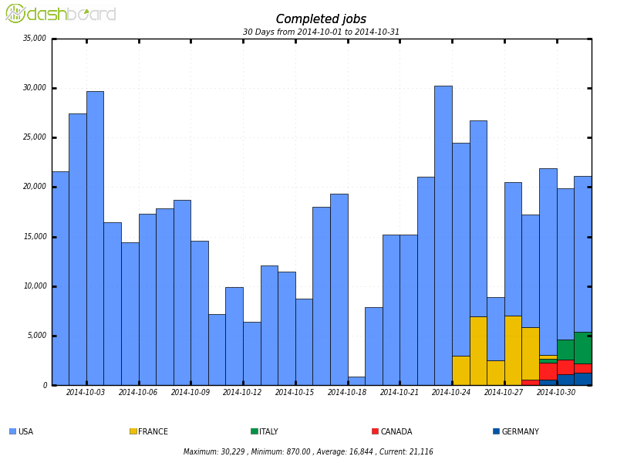
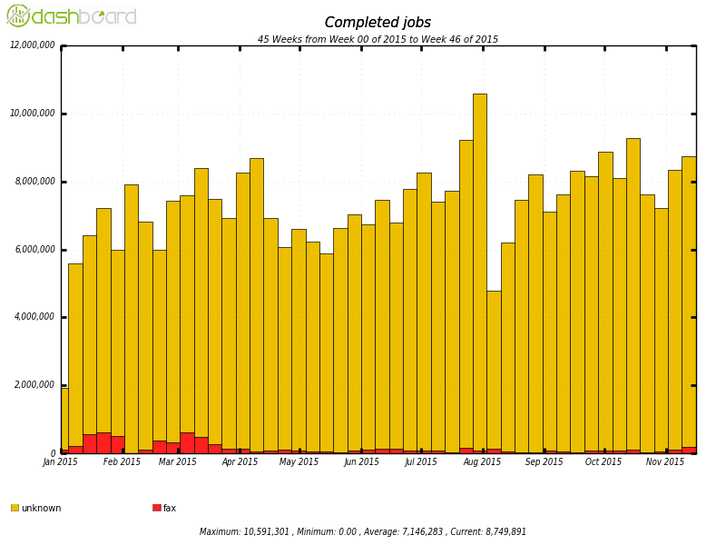
Early Example from Oct, 2014
How do we measure success?
Let’s look at example task.
This
Year

Slide 25
Jobs from task 4199733 on oct 3

Slide 26
Job wait times for example task

Slide 27
Conclusions for Case 1
Network data collection working well
Additional algorithms to combine network data will be tried
HC tests working well – PS data not robust yet
PanDA brokerage worked well
Achieved goal of reducing wait time – though anecdotally
Well balanced local vs remote access
Need fine tuning – we have a lot of data now
We have overflow working for FAX
We need deeper study to optimize

Slide 28
Case 2: Cloud Selection
Second use case for network integration with PanDA
Optimize choice of T1-T2 pairings (cloud selection)
In ATLAS, production tasks are assigned to Tier 1’s
Tier 2’s are attached to a Tier 1 cloud for data processing
Any T2 may be attached to multiple T1’s
Currently, operations team makes this assignment manually
This could/should be automated using network information
For example, each T2 could be assigned to a native cloud by operations team, and PanDA will assign to other clouds based on network performance metrics

Slide 29
DDM Sonar Data
http://aipanda021.cern.ch/networking/t1tot2d_matrix/

Slide 30
Tier 1 View

Slide 31
Tier 2 View

Slide 32
Improving Site Association

Slide 33
Conclusion for Case 2
Worked well as a demonstrator
Migrating to concept of “World Cloud”
Any site can be potentially “Nuclues” for data aggregation
Any other site can provide processing
Removes Tier1-2 hierarchy
Network integration is crucial for this new implementation

Slide 34
Operationalizing perfSONAR
WLCG has formed Working Group for LHC experiments
Network and Transfer Metrics WG – chaired by Marian Babik & Shawn McKee
https://twiki.cern.ch/twiki/bin/view/LCG/NetworkTransferMetrics
Mandate
Ensure all relevant network and transfer metrics are identified, collected and published
Ensure sites and experiments can better understand and fix networking issues
Enable use of network-aware tools to improve transfer efficiency and optimize experiment workflows
Report 05/11/2015
perfSONAR collector, datastore, publisher and dashboard now in production (stable operations)

Slide 35
From Marian Babik

Slide 36
From Marian Babik

Slide 37
From Marian Babik

Slide 38
Conclusion
Rich area for future R&D
Moving from “timeouts” to “metrics” based approach
Direct integration of network information in decision making
Next step – direct interaction with network elements

Slide 39
Live Pages
http://dashb-atlas-job.cern.ch/dashboard/request.py/dailysummary
http://aipanda021.cern.ch/networking/t1tot2d_matrix/
http://aipanda021.cern.ch/networking/CurrentHomeForeignT2SitesPerCloud/

