Slide 1
Enabling Collaboration in Data Intensive Science: the OSiRIS Project
November 19th, 2015
Michigan Booth (2103) at SC15
Shawn McKee / Physic Department

Slide 2
Overview of this Presentation
  Introduction: About me and OSiRIS
  Challenge: Extracting meaning from ever increasing volumes and types of data
  The Project Details
  Status and Plans
  Conclusion

Slide 3
A little about me…
I am a research scientist in the Physics department who has worked for many years at the intersection of technology and science
  I am involved in the search for Dark Matter using the ATLAS experiment
Director of the ATLAS Great Lakes Tier-2 Center (split between UM and MSU) https://www.aglt2.org/
  Serves the ATLAS experiment at CERN in Geneva Switzerland
  Has 3.7 Petabytes of disk and 6400 job-slots with a grid computing interface. Has been running for almost 10 years now…
US ATLAS Network project manager and Open Science Grid Network Area Coordinator
Director of a new Center within the Michigan Institute for Computational Discovery and Engineering :
  The Center for Network and Storage-Enabled Collaborative Computational Science
Principal Investigator on OSiRIS, a newly Funded NSF Campus Cyberinfrastructure - Data, Networking, and Innovation Program (CC*DNI) DIBBS grant:
  MI-OSiRIS (Multi Institutional Open Storage Research InfraStructure)
  Approximately $5M (~$1M/year). See http://www.nsf.gov/awardsearch/showAward?AWD_ID=1541335

Slide 4
NSF is Seeking Solutions
Many scientific disciplines are rapidly increasing the size, variety and complexity of data they must work with. As the data grows, scientists are challenged to manage, share and analyze that data and become diverted from a focus on their scientific research to data-access and data-management concerns.
  Even more problematic is determining how to support many scientists sharing and accessing this ever increasing amount of data.
How can we provide suitable infrastructure to enable scientists to collaboratively extract scientific results from large, distributed or diverse data?
NSF asked for proposals to address this in last year's CC*DNI DIBBs program: Goal is a replicable model

Slide 5
The Multi-Institutional Data Challenge
Scientists working with large amounts of data face many obstacles in conducting their research
  Typically the workflow needed to get data to where they can process it becomes a substantial burden (along with the bookkeeping)
The problem intensifies when adding in collaboration across their institution or especially beyond their institution.
Institutions have sometimes responded to this challenge by constructing specialized infrastructures to support specific science domain needs.
  This doesn’t scale and can be expensive (in many ways)
The OSiRIS team proposed a research project to investigate a possible solution

Slide 6
Who is the OSiRIS Team ?
OSiRIS is composed of scientists, computer engineers and technicians, network and storage researchers and information science professionals from the 3 main research Universities in Michigan: University of Michigan, Michigan State University and Wayne State University
We have a wide-range of science “stakeholders” who have data collaboration and data analysis challenges to address within, between and beyond our campuses:
  High-energy physics, High-Resolution Ocean Modeling, Degenerative Diseases, Biostatics and Bioinformatics, Population Studies, Genomics, Statistical Genetics and Aquatic Bio-Geochemistry

Slide 7
The OSiRIS Project Summary
We proposed to design and deploy MI-OSiRIS (Multi-Institutional Open Storage Research Infrastructure) as a pilot project to evaluate a software-defined storage infrastructure for our primary Michigan Research Universities. OSiRIS will combine a number of innovative concepts to provide a distributed, multi-institutional storage infrastructure that will allow researchers at any of our three campuses to read, write, manage and share their data directly from their computing facility locations.
  Our goal is to provide transparent, high-performance access to the same storage infrastructure from well-connected locations on any of our campuses. We intend to enable this via a combination of network discovery, monitoring and management tools and through the creative use of CEPH features as described below.
By providing a single data infrastructure that supports computational access on the data “in-place”, we can meet many of the data-intensive and collaboration challenges faced by our research communities and enable these communities to easily undertake research collaborations beyond the border of their own Universities.

Slide 8
Why OSiRIS?
Scientists get customized, optimized data interfaces for their multi-institutional data needs.
Network topology and perfSONAR-based monitoring components ensure the distributed system can optimize its use of the network for performance and resiliency.
OSiRIS, via CEPH, provides seamless rebalancing and expansion of the storage.
A single, scalable infrastructure is much easier to build and maintain
Allows universities to reduce cost via economies-of–scale while better meeting the research needs of their campus.
Eliminates isolated science data silos on campus.
  Data sharing, archiving, security and life-cycle management are feasible to implement and maintain with a single distributed service.
  Data infrastructure view for each research domain can be optimized

Slide 9
What is Ceph?
From Wikipedia:
  “Ceph is a free software storage platform that stores data on a single distributed computer cluster, and provides interfaces for object-, block- and file-level storage. Ceph aims primarily to be completely distributed without a single point of failure, scalable to the exabyte level, and freely available.
  Ceph replicates data and makes it fault-tolerant, using commodity hardware and requiring no specific hardware support. As a result of its design, the system is both self-healing and self-managing, aiming to minimize administration time and other costs.”

Slide 10
Why Ceph for OSiRIS?
Ceph gives us an Open Source platform to host our multi-institutional science data
  We can tune each science domains storage components to best meet their task
  Multiple interfaces between users and data are possible
  Has aspects of Software Defined Storage built-in which give us options for data lifecycle management automation
The combination of self-healing and self-managing make it very attractive to us.
It allows us to assign each science domain sets of disks which isolates science users from one another while allowing us to customize and optimize the storage for each science use-case.
Ben Meekhof/Physics has a nice online presentation of the Ceph details at https://umich.app.box.com/s/f8ftr82smlbuf5x8r256hay7660soafk

Slide 11
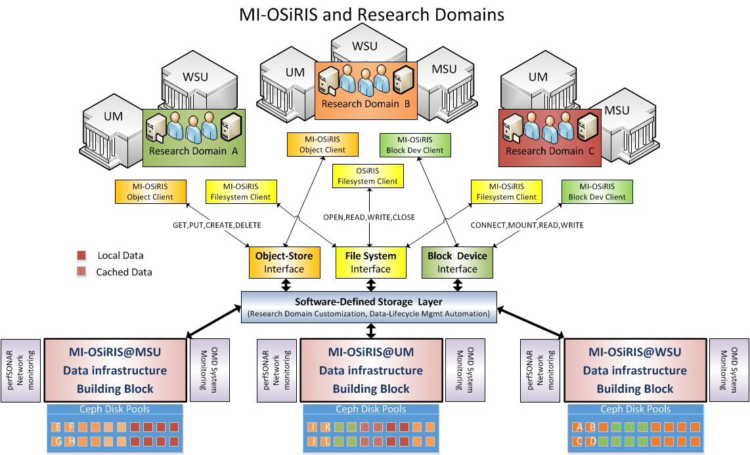
Logical View of OSiRIS

Slide 12
Main Attributes of OSiRIS
Provides a software-defined storage service for multi-institutional domains.
Incorporates Software Defined Networking to interconnect data and users
Enables storage-integrated data lifecycle management possibilities.
Built from inexpensive, commercial off-the-shelf (COTS) components.
Robust, reliable infrastructure constructed to minimize single points of failure.
High performance by integrating high-bandwidth network links, a large number of disk spindles, large server memory and SSDs.
Built using open source software components allowing the project to customize specific components to provide required OSiRIS functionality.
Incorporates detailed monitoring of the infrastructure/network topology.
Enables cloud infrastructures, e.g., OpenStack("OpenStack," 2014).
Collaborative storage for researchers/resources outside of our campuses.
  Connected to the Internet at 10 to 100 Gbps
  Uses Globus Connect(Alliance, 2014) GridFTP-based Data Transfer Nodes (each at 4x10Gbps) for wide-area data transfer

Slide 13
Software Defined Networking?
Software defined networking (SDN) changes traditional networking by decoupling the system that makes decisions about where traffic is sent (the control plane) from the underlying systems that forward traffic to the selected destination (the data plane).
Using SDN we can centralize the control plane and, using software, programmatically update how the network behaves to meet our goals.
For OSiRIS the network will be a critical component, tying our multi-institutional users to our distributed storage components.

Slide 14
Aside about Networking…
Networking is a critical underlying component of any type of distributed infrastructure.
  Large science collaborations couldn’t even exist without good networks to enable them
High-energy Physics has long focused on enabling and exploiting high-performance networks because we have:
  1000s of physicists per collaboration, globally distributed
  Many Petabytes (=10¹⁵ bytes) of data/year
  Significant needs for computing/storage to analyze this data

Slide 15
Network Monitoring & perfSONAR
Because networks underlie distributed cyberinfrastructure, monitoring their behavior is very important
The research and education networks have developed perfSONAR as a extensible infrastructure to measure and debug networks (http://www.perfsonar.net/ )
The CC*DNI DIBBs program recognized this and required the incorporation of perfSONAR as part of any proposal.
For OSiRIS, we were well positioned since I lead the worldwide perfSONAR deployment effort for the LHC community: https://twiki.cern.ch/twiki/bin/view/LCG/NetworkTransferMetrics
  We intend to extend perfSONAR to enable the discovery of all network paths that exist between instances
  SDN can then be used to optimize how those paths are used for OSiRIS

Slide 16
OSiRIS Challenges
SYSTEM optimization to maintain a sufficient quality of service for all stake-holders.
Enabling the gathering and use of metadata to support data lifecycle management.
Research domain customization using CEPH API and/or additional services.
Management of “quotas” and ACLs? How best to control data space and services?
Authorization which integrates with each campuses existing systems.

Slide 17
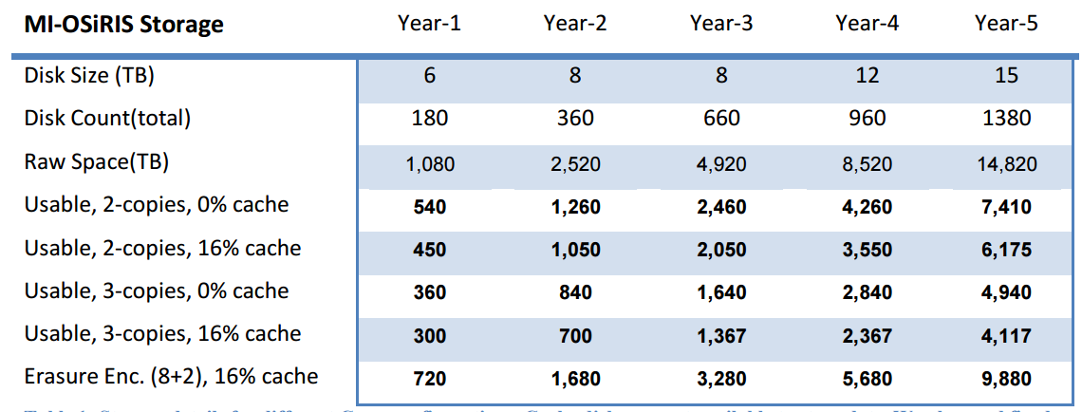
Planned OSiRIS Storage Evolution
The above table shows our assumptions for the amount of storage we might provide in OSiRIS by year.
We have options on how we organize the disks for each science domain
  The options trade-off size versus resiliency versus performance
We need to determine stakeholder needs and construct a plan to bring our science users into OSiRIS that will match our storage and person resources.

Slide 18
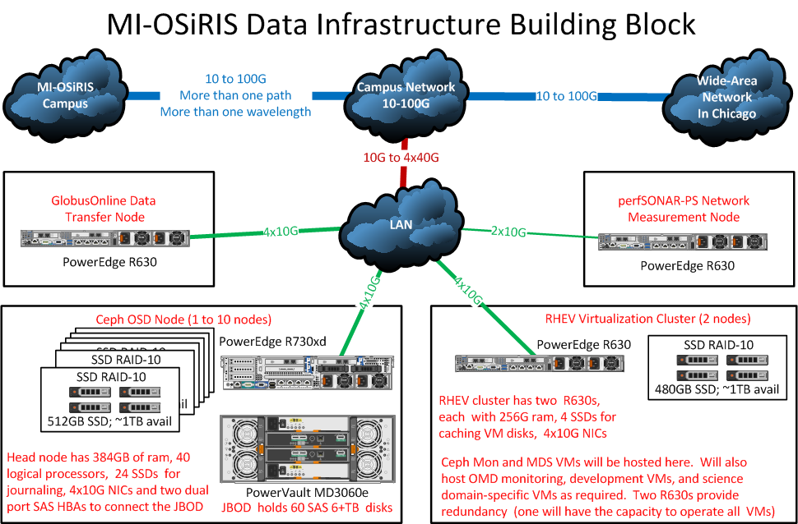
An OSiRIS Institutional Deployment

Slide 19
Project Timeline from Proposal
The project has two primary phases. The first half is devoted to developing, tuning and integrating the
hardware and software components while focusing on a few pilot science domains and the second half is focused on expanding the number of science domains served while continuing optimizations to provide a functional, effective multi-institutional system
Startup – First two months. This initiates the project.
Kick off meeting with research stakeholders to formalize MI-OSiRIS plans (Had this September 14th)
Define timeline for science domains to join OSiRIS
Create project webpage and initialize documentation, FAQ and How-To
Setup GitHub for OSiRIS Project
Place orders for year-1 equipment (in process now; talking to Dell 12:30 today)

Slide 20
Project Timeline Months 3-6
This quarter is project deployment, s/w dev.
Prepare hosting locations / network
Document initial CEPH setup
Receive/install year-1 equipment
RHEV clusters installed, provide VMs
Shibboleth design completed for perfSONAR/CEPH
UNIS agent / topology design, prototype

Slide 21
Project Timeline Months 7-12
This half-year is for MI-OSiRIS commissioning.
Optimize CEPH for distributed setup
Deploy augmented perfSONAR, Globus Connect and OMD monitoring
Develop Straylight 2.0
Science domain testing of OSiRIS
End of year evaluation report/meeting
Gather, summarize, publish metrics
Discussions for data-lifecycle metadata

Slide 22
Project Timeline: Years 2-5
OSiRIS into pre-production, finalize S/W
First pilot science users added
Document requirements, new metrics
Implement production Shib-CEPH
Harden network topology code
Each year from then on:
Order year-N hardware
End of year evaluation report/meeting
Gather, summarize, publish metrics
Optimize, tune, document configuration
Receive/deploy/test year-N equipment
Prep for next science domains
Update OSiRIS documentation.

Slide 23
Project Organization/Management
The OSiRIS project is hiring a dedicated full-time engineer at UM to spearhead its deployment, management, evaluation and interface to the various science domains.
  Both MSU & WSU will provide engineers at the 35% FTE level.
The PI / Co-PIs will steer the overall project and be responsible for the technical direction (including technology choices and cost optimizations) as well as the high-level interface definitions for the science domains.
The project also intends to hire talented graduate students for coding and software development and undergraduates to work on maintenance and upkeep for OSiRIS as well as for taking on small but challenging projects within OSiRIS, e.g., improving monitoring or alerting, improving user interfaces, augmenting security, finding system bottlenecks, creating or updating specific documentation, etc.
The project will be organized and managed via bi-weekly phone or face-to-face meetings of the PI, CoPIs, engineers and students (called the OSiRIS project team), and sometimes including stake-holder representatives.
Skype will be used to facilitate “on-demand” communication.

Slide 24
Project Metrics / Evaluation
Tangible Metrics
Used bandwidth to/from storage in total, by interface type (object-store, block and file system) and by research domain.
Storage usage in total, by interface type, by site location and by research domain.
Cache usage by site and science domain.
Delivered IOPs in total, by interface type and by research domain.
Update / Unplanned outages, both for all of OSiRIS and by research domains.
Data access stats (bandwidth, IOPs) on local site vs. remote site vs. from outside our sites.
New collaborations initiated because of OSiRIS existence.
Example survey questions for feedback
What aspects of OSiRIS a most effective in supporting your research goals?
What aspects of OSiRIS are problematic for you?
Do you have data needs that are not met by OSiRIS?
What customizations or tunings would make OSiRIS more effective for you?
Are you able to collaborate internally and externally using data in OSiRIS?
What features are missing from OSiRIS to make it better meet your needs?

Slide 25
Status and Plans
OSiRIS is on-track to have the hardware and initial Ceph installation operational by March 2016.
Current focus is finalizing which hardware and which vendor to purchase from.
Lots of work going on in sub-groups focused on the networking and authorization areas which we need to develop for OSiRIS
First science user will be high-energy physics starting in April 2016.

Slide 26
Remember the Goal
The OSiRIS project is one attempt to try to address better enabling scientists to more easily collaborate without having to focus on the “how”.
  The science domains mentioned all want to be able to directly work with their data without having to move it to their compute clusters, transform it and move results back
  Each science domain has different requirements about what is important for their storage use-cases: capacity, I/O capability, throughput and resiliency. OSiRIS has lots of ways to tune for these attributes (just not all of them at once!)

Slide 27
Summary
There are significant challenges in providing infrastructures that transparently enable scientists to quickly and easily extract meaning from large, distributed or diverse data.
OSiRIS is targeting doing exactly this and intends to incorporate a number of cutting edge technologies to provide such an infrastructure.
Questions?

Slide 28
Center for Network and Storage-Enabled Collaborative Computational Science
The Center for Network and Storage-Enabled Collaborative Computational Science seeks to address the challenges of extracting scientific results collaboratively from large, distributed or diverse data.
The following questions illustrate some of the focus areas the center is exploring:
  What are the best practices for collaboratively working on large, potentially diverse or distributed, datasets?
  What tools, technologies and techniques are most effective at addressing the challenges faced by such researchers?
  How should data best be stored, organized, indexed and made accessible to improve the ability of scientists to jointly work with one another, especially across the dimensions of time and space?
The center supports its members and the broader scientific community in sharing expertise, knowledge and practical methods that can better enable scientific discovery for groups of scientists working together on “big, distributed or diverse data”.

