Slide 1
Simple Infrastructure to Exploit 100G Wide Are Networks for Data-Intensive Science
Shawn McKee / University of Michigan
Supercomputing 2015 Austin, Texas

Slide 2
What Are We Doing Here?
Michigan is participating in a couple network demonstrations for SC15 and they both involve 100G wide-area networks and SDN (Software Defined Networking) [See rack left of screen]
Our two Network Research Exhibitions demonstrations are described on the SC15 NRE website
http://sc15.supercomputing.org/conference-program/research-scinet/nre-demos-2015
LHCONE Point2point Service with Data Transfer Nodes
Partners: Caltech #1248 and Vanderbilt #271
SDN Optimized High-Performance Data Transfer Systems for Exascale Science
Partners: California Institute of Technology / CACR #1248, University of Michigan #2103, Stanford University #2009, OCC #749, Vanderbilt #271, Dell #1009, and Echostreams #582

Slide 3
The Michigan Net-Demo Focus
The two main demonstrations focus on our LHC-ATLAS related needs for high-performance networking
ATLAS is one of the two large general purpose experiments at the Large Hadron Collider (LHC)
The demos highlight the effective use of 100G wide-area paths coordinated via the use of SDN. Our collaboration has selected Openflow 1.3 and the Open Daylight controller
At the Michigan booth we are very interested in what the “minimal” infrastructure required to exploit 100G WAN paths is…

Slide 4
Why Minimal?
For our work in high-energy physics we have a large number of sites and institutions participating and there is a large range in the size and expertise available for each of them.
Big sites with many experts are capable of effectively deploying and configuring enough storage systems to take maximum advantage of their networks.
Physicists working at these sites get the fastest possible access to new data which may hold the key to the next big discovery
However there are many smaller sites who lack either the local technical expertise or can only afford a few storage systems which aren’t able to fully exploit their 10G, 40G or 100G institutional network.
Physicists at these sites are not able to participate in as timely a way
The interesting question for me is What is the “minimal” infrastructure we can develop that is capable of effectively utilizing high-speed networks to move data?
The idea is to be able to recommend infrastructure that even small sites could deploy to expedite getting data in-to or out-of their site

Slide 5
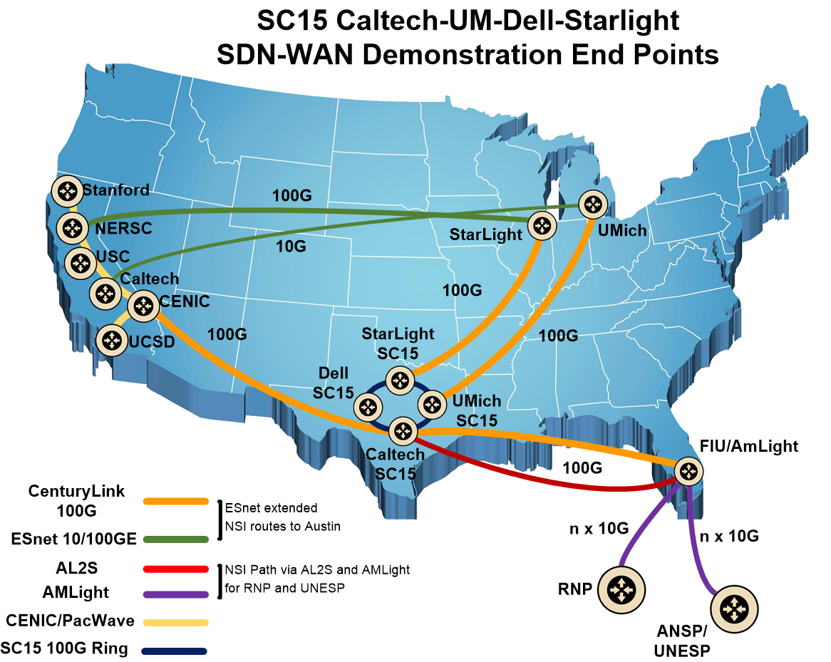
Big Picture of the SDN WAN Demo

Slide 6
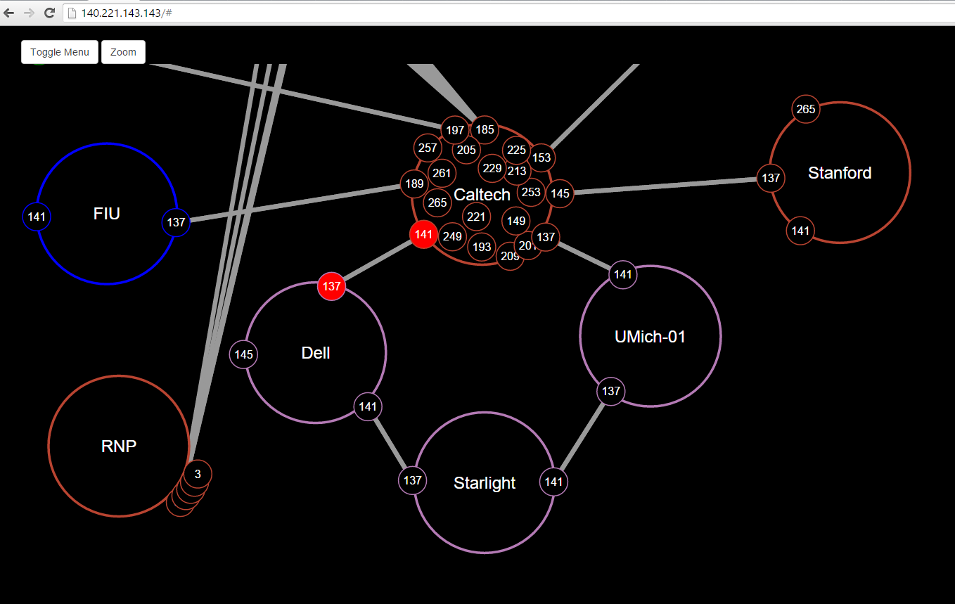
Real-time Visualization of Demo
A real-time OpenFlow fabric visualization for our is available at http: //140.221.143.143 (Caltech)

Slide 7
Demo Status
Our Demos are still “under-construction” as we deal with the usual challenges of SC
Making various hardware and software inter-operate
Having minimal time to actually have the equipment on-hand to develop and test
Dealing with hardware, firmware and software components and their configuration, tuning and optimization
We just got the final hardware pieces in place today to construct the end-to-end path to Michigan
Still facing some challenges getting Openflow 1.3 setup on all the network devices along the path

Slide 8
Details of the Path to AGLT2

Slide 9
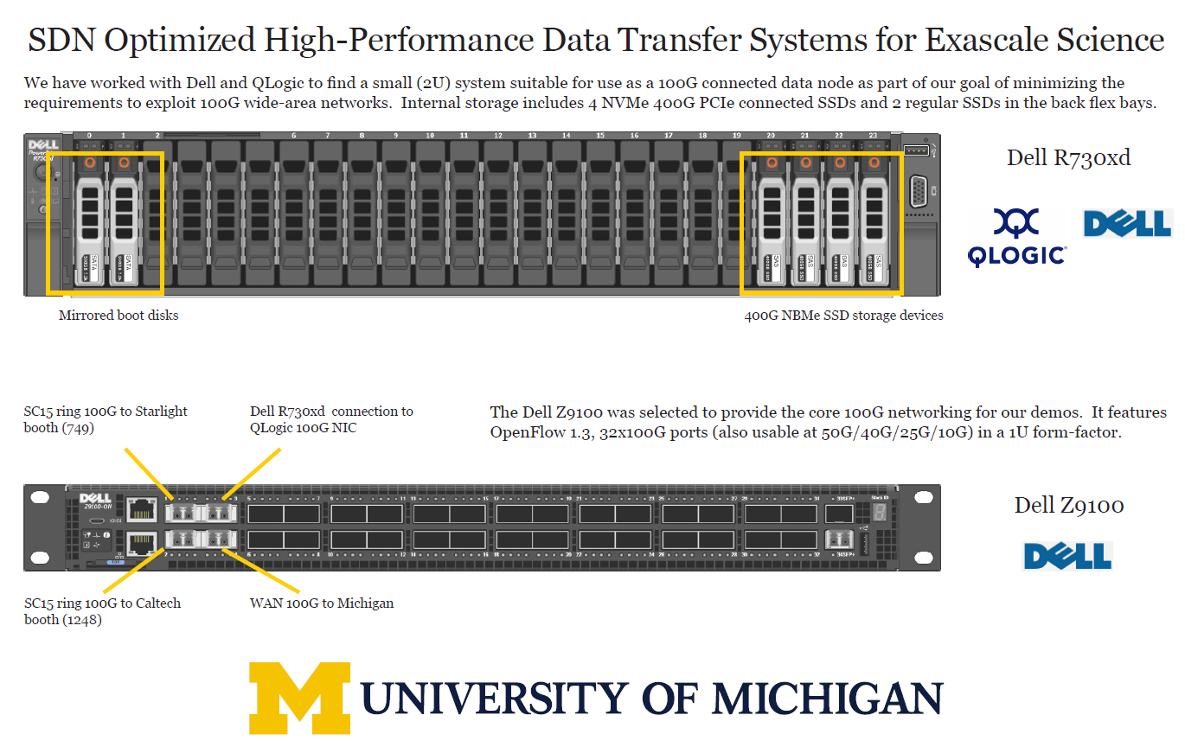
What We Have for Minimal

Slide 10
Plans for the Rest of the Week
Today we should complete all the Openflow setup and begin final tweaking of the transfer paths
The next two days we will be starting sets of flows across the infrastructure and using SDN to manage how those flows share the possible paths
Check Caltech’s real-time Openflow web page during the week to see how we are doing

Slide 11
Thanks to our Partners
We couldn’t do these kinds of demos without our partners.
Thanks to Caltech, Dell, Starlight, Century Link, ESnet, U. Texas Arlington, Stanford, Merit Network, ADVA, QLogic and Juniper

Slide 12
Questions or Comments
Conclusion
I wanted to leave time for questions, comments and discussion
Any topics you want more details about?
Comments or suggestions?
Questions ?

