Slide 1
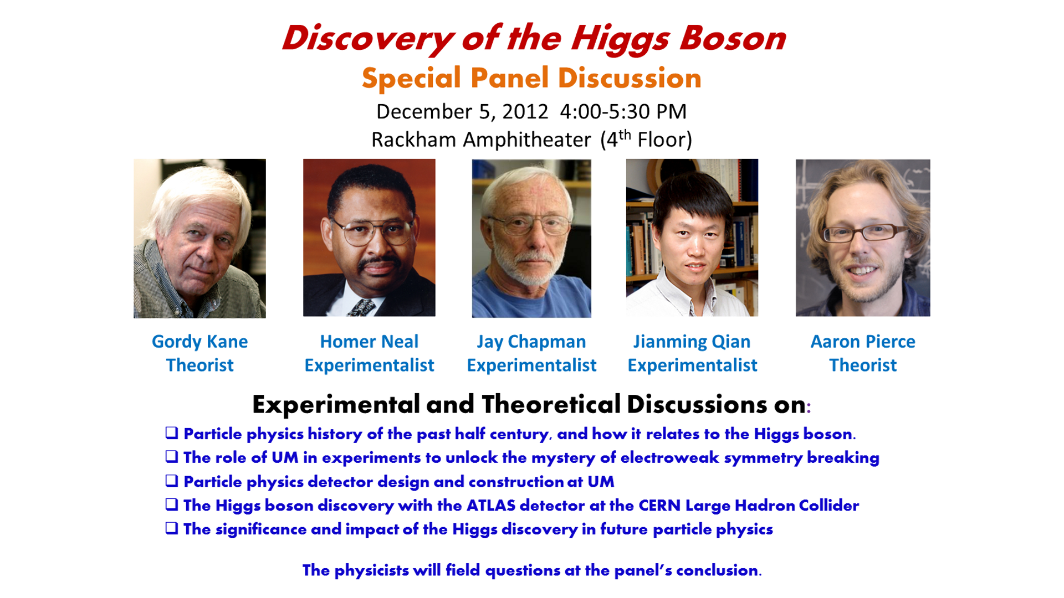

Slide 2
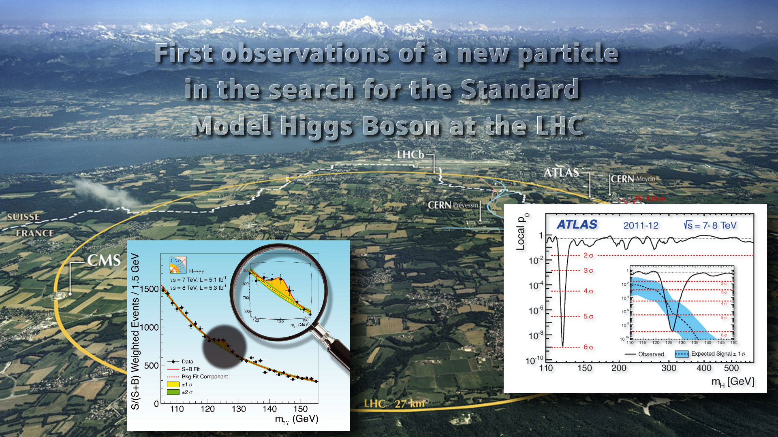
Discovery of Long Sought Higgs Boson

Slide 3
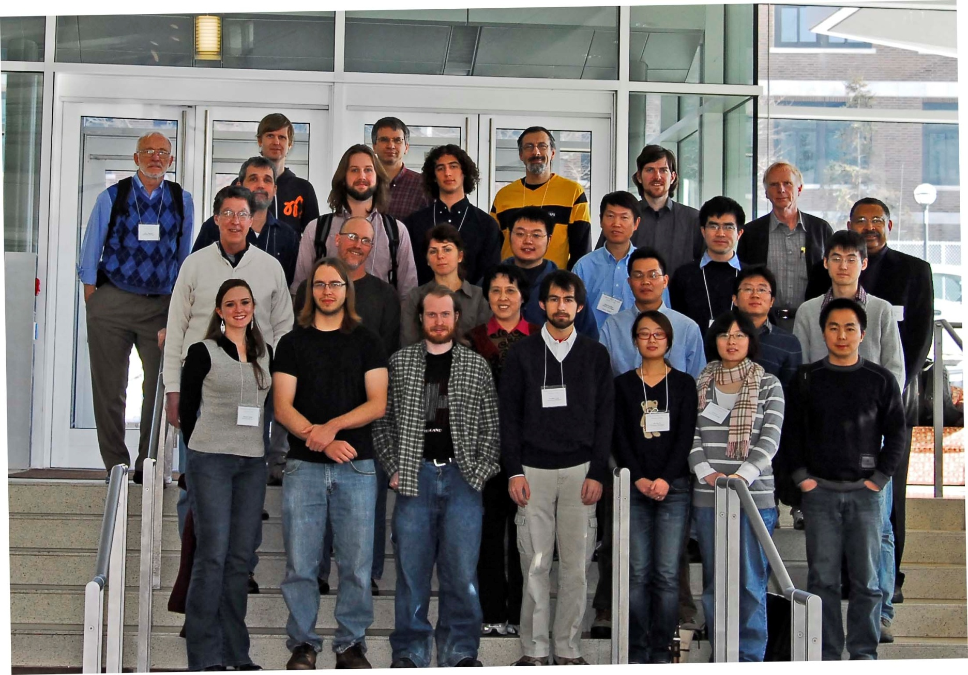
Huge Efforts at U of M Over Past Decade
ATLAS Faculty:
J. Chapman, H. Neal J. Qian, R. Thun, B. Zhou, J. Zhu, D. Amidei, G. Tarle
Research Scientists:
E. Diehl, S. Goldfarb, D. Levin, S. McKee, H. Yang, Z. Zhao
Scientific engineers:
J. Ameel, B. Ball, T. Dai, J. Dubbert, C. Ferretti, J. Gregory, J. Herr, D. Kobe, B. Lougheed, H. Schick, J. Yanchula
Postdoctoral Researchers:
R. Avromidou, S. Borroni, M. Cirilli, S. Hou, X. Li, J. Liu, N. Panikashvili, J. Searcy, J. Strandberg, A. Wilson, G. Wood, Y. Wu, Q. Xu, D. Zhang
Graduate Students:
A. Armbruster, A. Burgers, Cheng, A. Eppig, L. Guan, D. Harper, L. Hao, X. Li, L. Liu, N. Lu , H. Feng, J. Long, U. Paudel, J. Purdham, D. Scheirich, S. Walch, A. Wilson, Y. Wu, J. Yu, L. Xu
Undergraduate students: 65
Very strong Support from
Physics Department, LS&A, Provost & OVPR

Slide 4
HIGGS PHYSICS before the DISCOVERY
Gordy Kane
December 2012
Pre-LHC Higgs physics
Pre-LHC history
Mention pre-LHC Higgs physics theory at University of Michigan
Not simple…

Slide 5
Goal of particle physics is to understand our world as well as we can – find and understand origin of the underlying laws of nature
“Standard Model” synthesis of  400 years, since Galileo and Kepler --
Discovery of Higgs boson last step to complete the Standard Model
And Higgs boson properties point to how to go Beyond-the-Standard Model, find a deeper underlying theory that incorporates the SM

Slide 6
“STANDARD MODEL” OF PARTICLE PHYSICS
All forces (electromagnetic, strong, weak, gravity classical) – describes all we see – many tests
What we see is built of electrons plus two quarks (up, down), bound by photons, gluons – Weak interactions mediated by W, Z bosons
Quarks → protons, neutrons → nuclei, + electrons → atoms →molecules etc -- quantitative, not metaphors
Predictions of SM correct, except electrons, quarks, W, Z must be massless or theory inconsistent – adding Higgs field can allow mass
So Higgs field predicted – Higgs bosons are quanta of Higgs field
PHYSICS 521 (January-April)

Slide 7
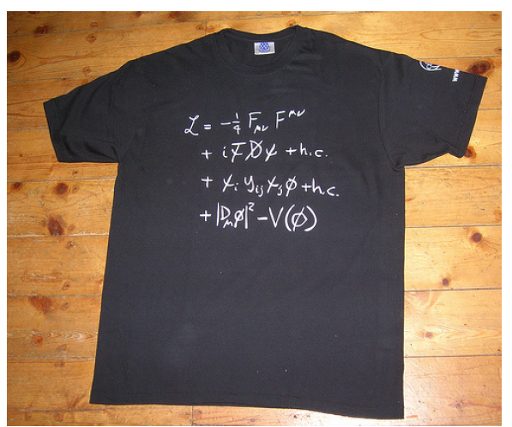
Higgs
Standard Model Lagrangian

Slide 8
HIGGS PHYSICS -- OLDER
In SM electrons, quarks, W, Z (and Higgs boson) have “weak charge”
What gets mass? – Anything with weak charge -- quarks, electrons, W, Z bosons, and Higgs boson – gets mass from interacting with Higgs field → mass term in Lagrangian
Protons, neutrons do not get mass from Higgs interactions (about 1%)
Size of atoms proportional to 1/m_{electron}
Not molasses etc – analogy not good, not technically ok
  -- No good analogy, this one better than none…

Slide 9
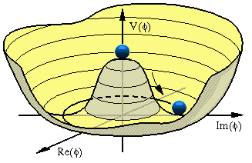
Vacuum = state of lowest energy of universe -- (Quantum fluctuations all the time, but average zero)
With EM field, state of lowest energy has zero field, Energy=E² + B²
For the Higgs field, state of lowest energy (vacuum) has non-zero field!
Higgs field with weak charge pervades vacuum of universe, Lorentz-invariant
[in SM assume this potential – in supersymmetry derive it (1982)]
Higgs bosons are Higgs field quanta
Higgs field zero

Slide 10
HIGGS HISTORY
In late 1940s quantum electrodynamics was shown to be “renormalizable” – i.e. , apparent infinities could be absorbed so theory could make finite predictions – then great progress in explanations and predictions
In early 1960s writing renormalizable theories of particles with non-zero mass wasn’t working for electrons and W, Z bosons
1964 – Peter Higgs argued could do it (in relativistic quantum field theory) for vector bosons that could mediate the weak interactions
[photon has two polarization states, massive vector boson of weak interactions has three – need complex scalar added, one part becomes longitudinal polarization state of W,Z and the other a real scalar particle → Higgs boson]
Also other theorists

Slide 11
Weinberg, Salam 1967 →with Higgs field it can also work for electrons, quarks
1971 – ‘t Hooft (based on work with Veltman) showed could have full renormalizable theory of (electro)weak interactions with mass if Higgs field existed, AND IF neutral Higgs got non-zero vacuum value
1970 through 1985, many tests of electroweak theory – W, Z bosons observed at CERN, 1985 (Glashow, Weinberg , Salam Nobel Prize 1979)
But Higgs boson mass not calculable in SM – worse, Higgs boson mass quadratically sensitive to heavy scales, so pure SM Higgs boson not OK

Slide 12
SM THEORY FULLY IN PLACE IN 1972 –
Then action shifted to how to produce and detect Higgs boson, and how to make sense of pure SM Higgs boson not making sense
1982 – large international “Snowmass” study, 3 weeks – I co-led working group on beyond-the-SM-theory – much Higgs physics not known then, e.g. how to calculate Higgs boson production rates at hadron collider – led to SSC proposal for a U.S. facility (∼ 1985) – Reagan: “throw deep” – cancelled in 1993
SSC, LHC proton-proton (hadron) colliders since could accelerate more protons to higher energies and steer them to collide – had to have high energies since didn’t know what Higgs mass to aim for – a collider is a device that converts energy into particles, E=Mc²
LHC (Large Hadron Collider) design also started 1984, to replace LEP e⁺ e⁻ collider then being constructed – not cancelled

Slide 13
GK – averaged a paper a year on Higgs physics since 1977, two in past year
Showed (with Gunion, Wudka 1984) that h→ was best way to observe h at high intensity hadron collider, even though only one Higgs boson in about 500 decayed this way
-- also h → Z Z*
In 1993 derived general upper limit on h mass in general supersymmetric theory (with Kolda, Wells)
Aaron Pierce, James Wells – considerable work on observing Higgs bosons, extensions of SM Higgs physics – also Kathryn Zurek

Slide 14
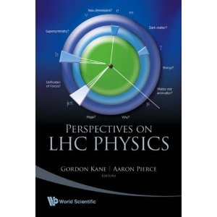

1989

Slide 15

The Michigan Path to the Higgs
Homer A. Neal
December 5, 2012

Slide 16
Presentation Targets
Factors leading to the SSC demise (while Michigan was focusing on SSC physics preparations)
The Michigan quest for the SSC
Period of Mourning when SSC was cancelled -- and Ultimate Revival
Choice of focus on Muon Spectrometer in ATLAS
Focus on design, prototyping, construction, installation ,monitoring of muon chambers
Massive LHC disruption by machine accident/ Resumption of data-taking and analysis
Higgs analysis leadership
Attempts to bring undergraduate students along
Leadership in designing, prototyping collaborative tools for large-scale collaborations
Discovery Elation!
Looking backward /forward at SSC failure (national science policy)

Slide 17
The Human Quest
From ancient times humans have wondered about the big questions of our Universe .. such as:
  Where did we come from
  How was the Earth formed
  What are those things in the Sky and why do they move in almost regular patterns
  What are the ultimate building blocks of matter
  …………………..

Slide 18
A Big Microscope
To look at small distances one needs probes at high energy
We needed a large or super collider to tackle the next set of problems in fundamental particle physics
We needed a machine of the order of 10 TeV in energy to look below the quark level and to search for the Higgs, SUSY, compositeness, etc.

Slide 19
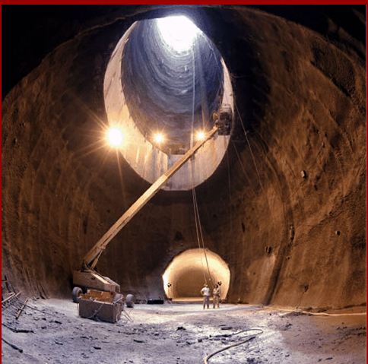
Circa 1988; A Bold Initiative to explore our understanding of matter – the SSC in Texas
For the reasons mentioned by Gordy Kane, the Higgs was the key object to be searched for at the SSC

Slide 20
Some Reasons the SSC Failed
The SSC suffered for having failed from the outset to incorporate international funding and participation.
The Reagan and Bush administrations made critical early decisions about the technical design and site location as if the SSC were purely a national project.
Only later did they proclaim it to be an international collaboration—with a goal of nearly $2 billion in foreign funding.
Substantial foreign funding never materialized
This shortfall eroded congressional support, which made foreign involvement even less likely, accelerating the project’s downward spiral

Slide 21
Michigan Pathway to the Higgs
Strong UM physics preparation for the SSC
Representation on SSC Board of Overseers
Devastation on cancellation of project
A period of rejection in Ann Arbor to joining large projects, even those being discussed in Europe
An evolving interest to join a LHC experiment
Decision to play a dominant role in ATLAS, the largest LHC experiment, and a commitment to become one of its most powerful groups;
LHC → here comes the Wolverines

Slide 22
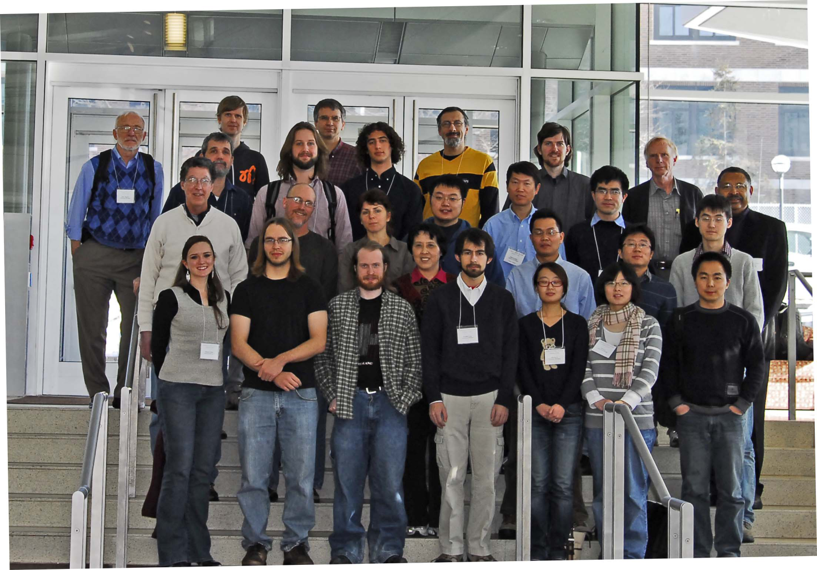
And we Grew and Grew … as the Collaboration Learned of our Strengths

Slide 23
We Contributed in a Large Variety of Areas to the LHC
Designing , Prototyping, Building, Commissioning and monitoring key elements of the ATLAS detector
Designing basic elements of the current computing infrastructure, and operating one of the key data analysis centers
Designing and operating one of the key muon calibration centers
Playing a seminal role in the physics analysis
Adapting collaborative tools so the multi-thousand person collaboration could communicate effectively with itself and with colleagues back home
Providing the only official portal for U.S. undergraduates and teachers to participate in and observe LHC research first-hand
------------------------------------------------------
I will just take a few minutes to explain the topics in yellow – the core topics in white will be covered by other colleagues)

Slide 24
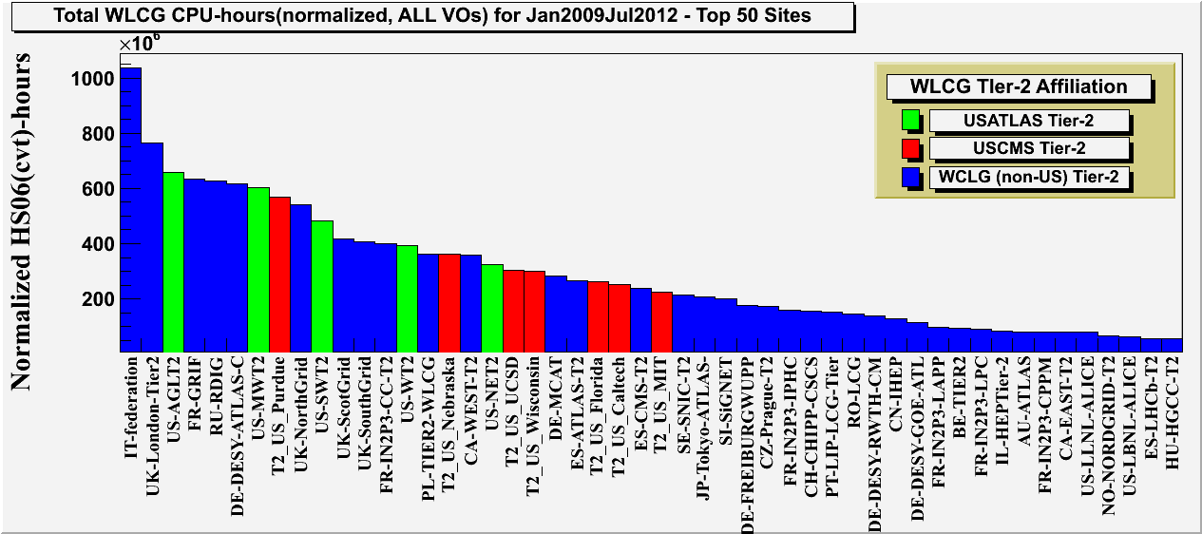
ATLAS Great Lakes Tier-2
Computing centers for High-Energy Physics providing resources for simulation and analysis
Michigan Tier-2 Center
Worldwide Tier-2 delivered CPU-hours. AGLT2 was third globally because of significant support from the University of Michigan and Michigan State University (#1 and #2 are consortiums of 12 and 7 sites respectively)

Slide 25

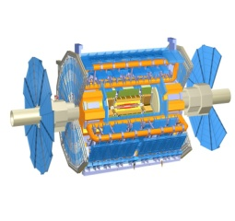
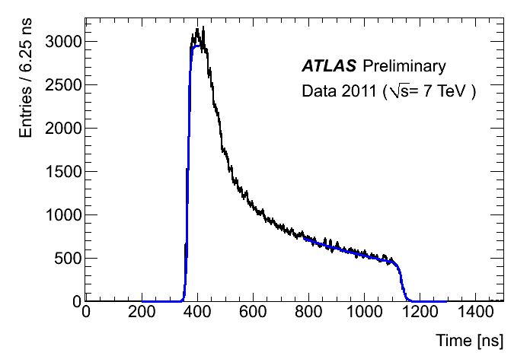


ATLAS Muon Spectrometer Calibration
The ATLA muon spectrometer measures muon momentum by measuring the deflection of muons in a magnetic field.
The muon spectrometer uses 350,000 drift tubes (31,000 made at Michigan) to track the muons with 80 micron accuracy.
Drift tubes require precision calibrations which are performed daily at calibration centers at Michigan, Rome, and Munich.
Calibrations include timing offsets and drift speed.
Data is streamed daily to the calibration centers and calibrations are performed and updated within 48 hours.
Calibration stream
Drift Tube
Time spectrum
100GB /day
100M Muons/day
Rome
ATLAS
Munich
~20 TB storage
per site

Slide 26
To the UM Administration and to our Department
For your help with our special needs for computing, space, staffing, collaborative tools, travel accommodations, and moral support -- we thank you.

Slide 27
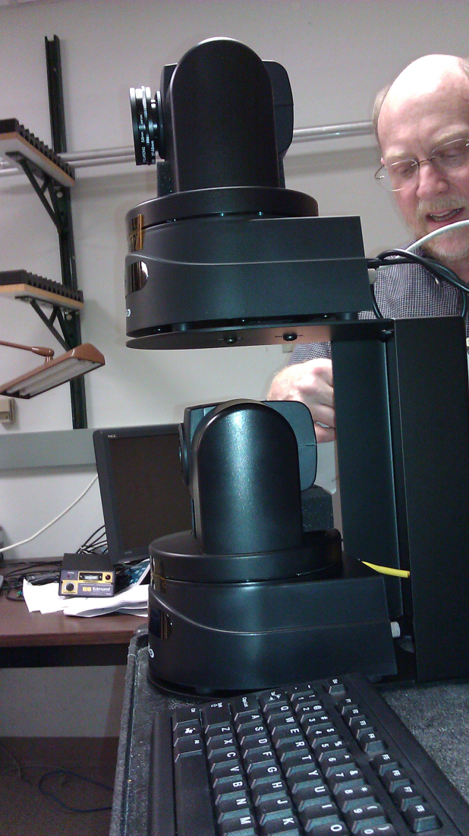
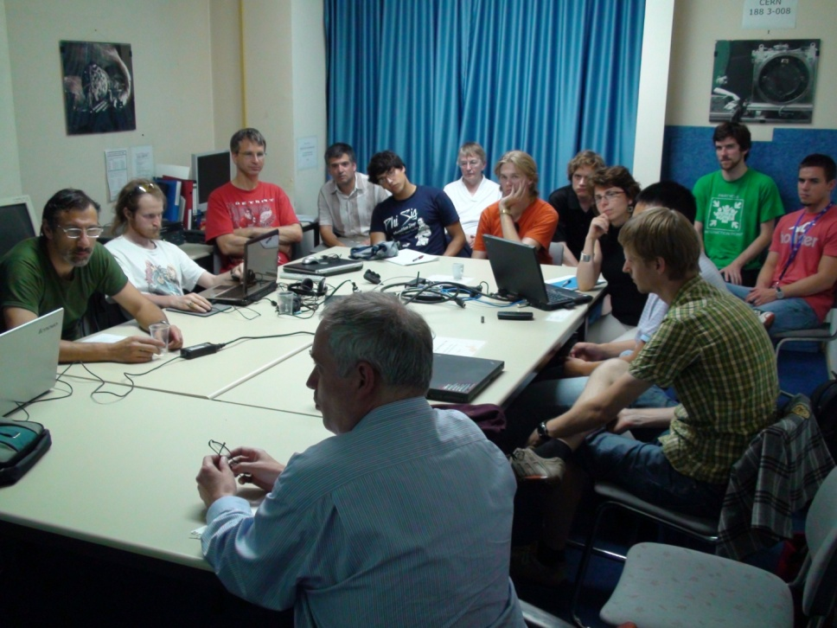
We contributed directly to collaborative tool developments→ Invented, Patented, Licensed a Next-Generation Camera for Tracking Speakers without a Camera Operator, and pioneered the use of QoS in videoconferencing, use of 3D VRML in detector design, convening of international conference, etc.
We drove the organization of the CERN/UM video conference facilities to help coordinate group activities – for ourselves and all groups
CERN-UM Conference Room -- Geneva

Slide 28
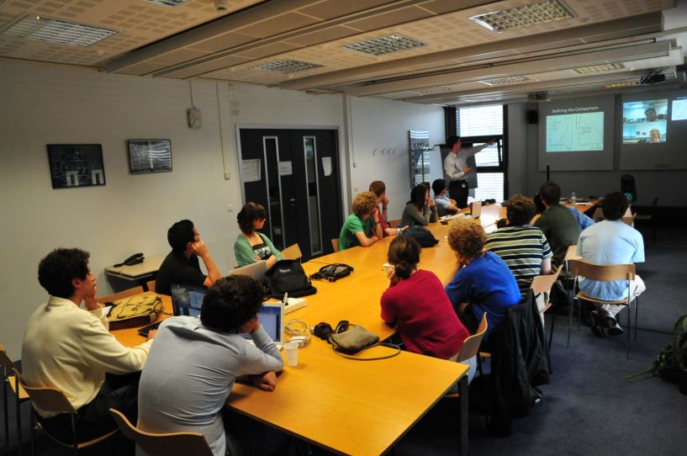
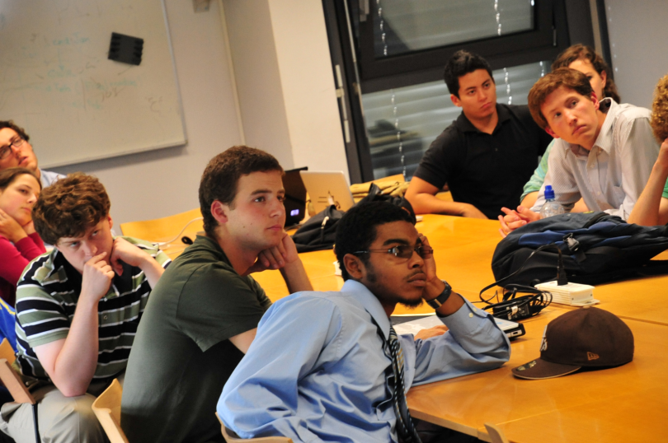
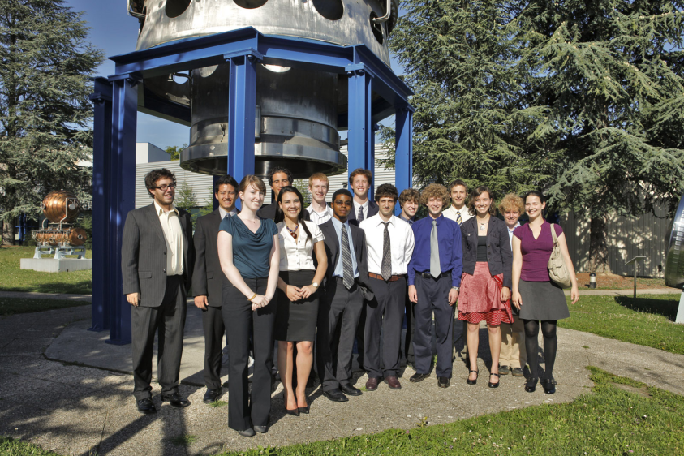
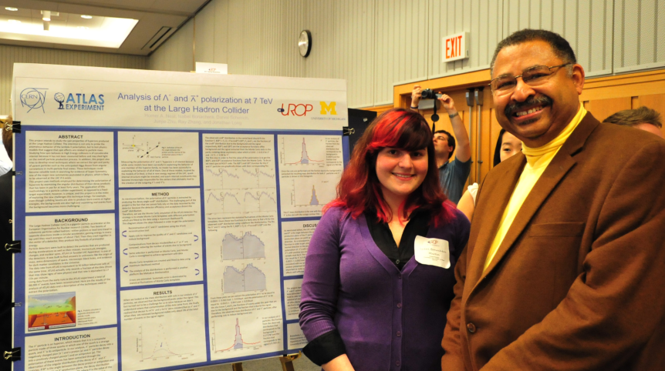
Established the only NSF REU CERN Site Program in Geneva to provide CERN Access to U.S. Students
Also involved UM Students locally via UROP Program

Slide 29
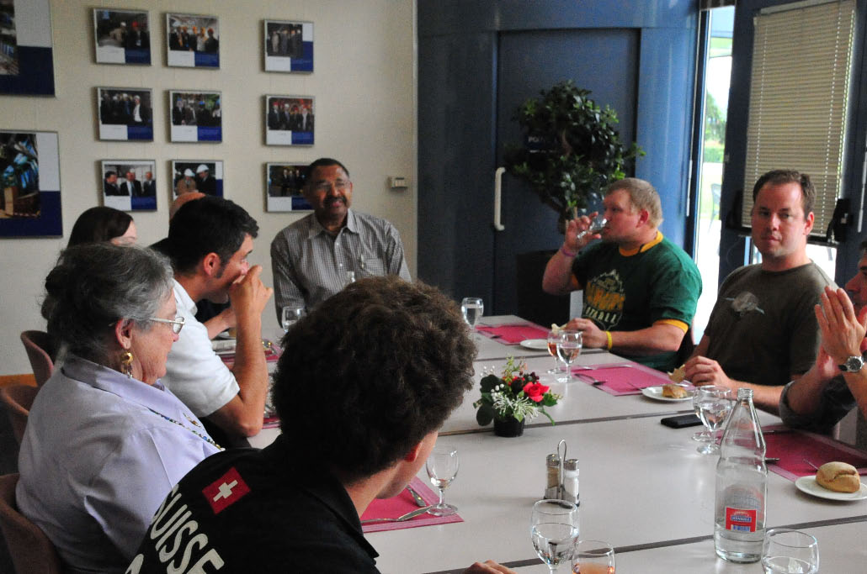
Provided LHC Access for US High School Teachers (via NSF RET Program)

Slide 30

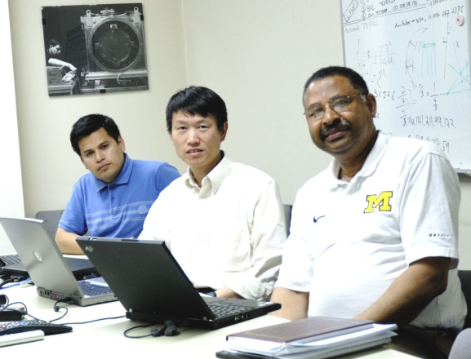
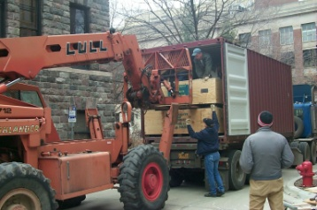
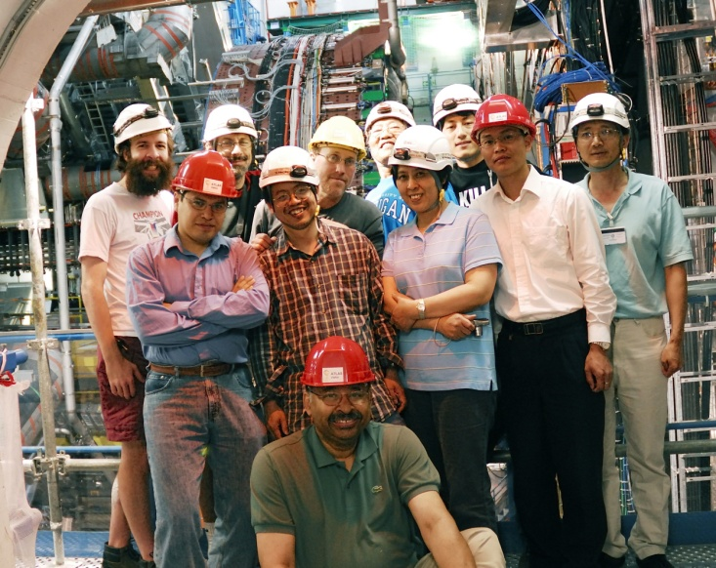
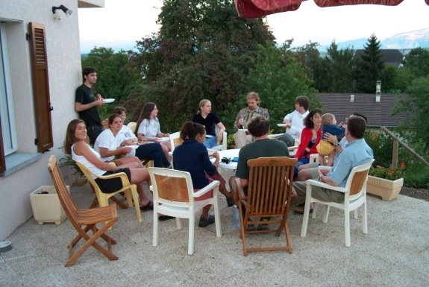
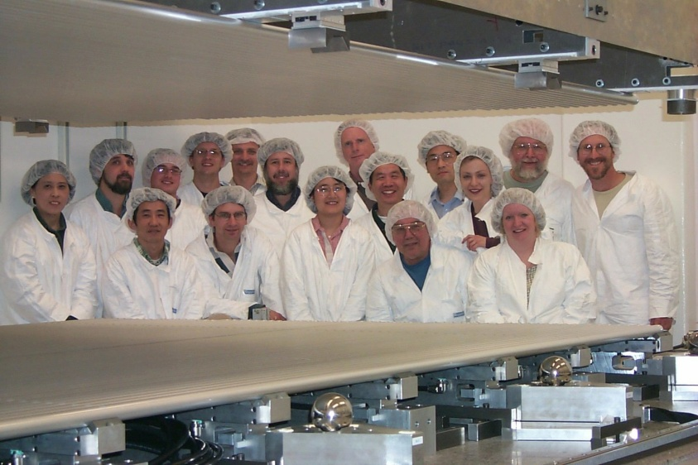
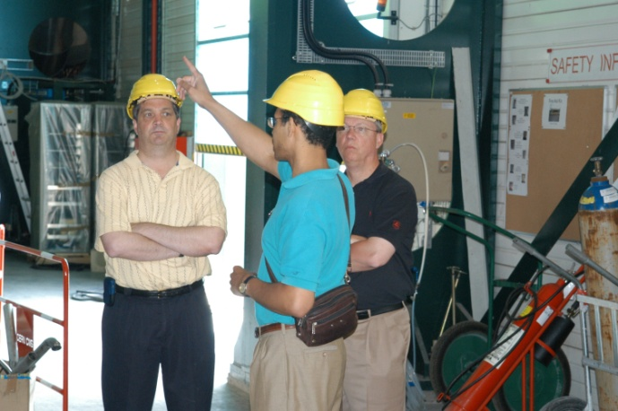
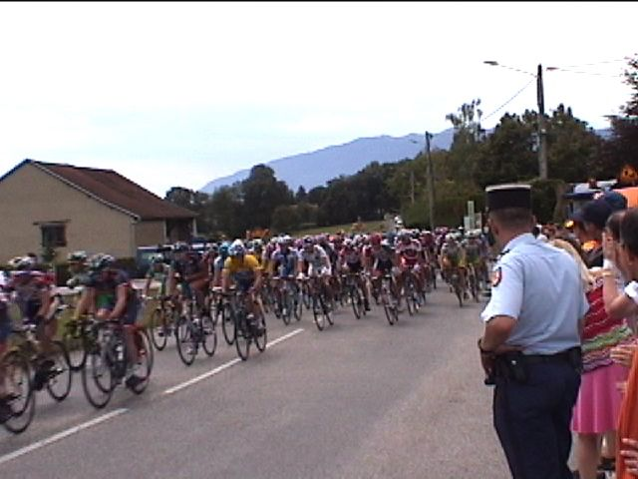
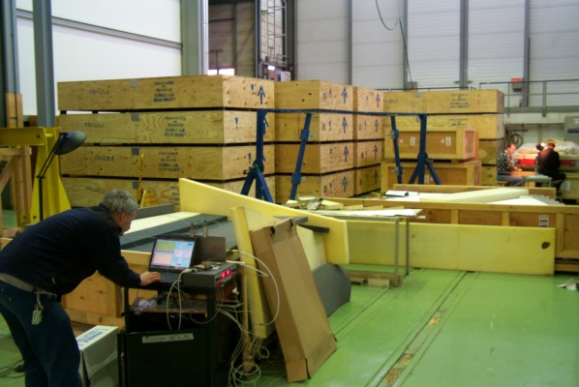
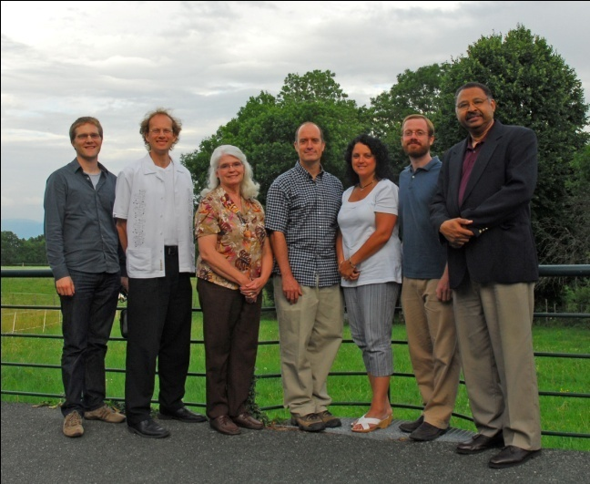
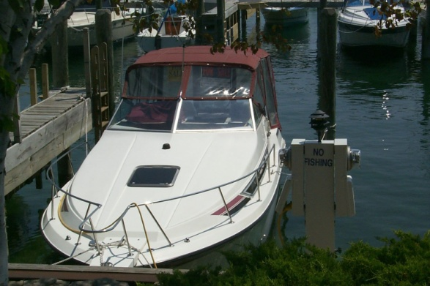
The Discovery of the Xi_b
A PERSONAL MONTAGE

Slide 31
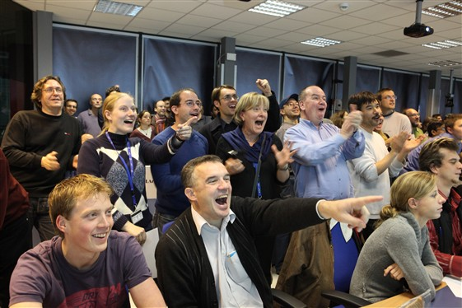
The Wait Was Worth It

Slide 32
Physics in the Extreme
ATLAS, the Largest Scientific Experiment
at the Large Hadron Collider
J. Chapman = umjwc@umich.edu
Notes:
I’d like to present at two part series about the work being carried out at CERN. The first part is intended to set the bases for the work, the physics and the imagery many of us (physicists) take when thinking about the world of the very tiniest objects known.

Slide 33
Extremes in LHC Physics
Very small size of the fundamental objects
Large size of the accelerator & detectors
Extreme precision for large devices (40μm)
Large size of the collaborations (ATLAS)
Data a billionth of a second after Big Bang
Very large data volume & huge computing requirement ~100K processors in huge grid
Geographically spread global community

Slide 34
Culturally Diverse (ATLAS)
40+ Countries involved in ATLAS alone.
28 Languages (meetings in English)
173+ Institutes & Universities
8 Detector Subsystems plus Utilities
~100 Million Channels of Electronics
Hundreds of Committees & Teams
A lot of Very Big Egos! Immense Talent!

Slide 35
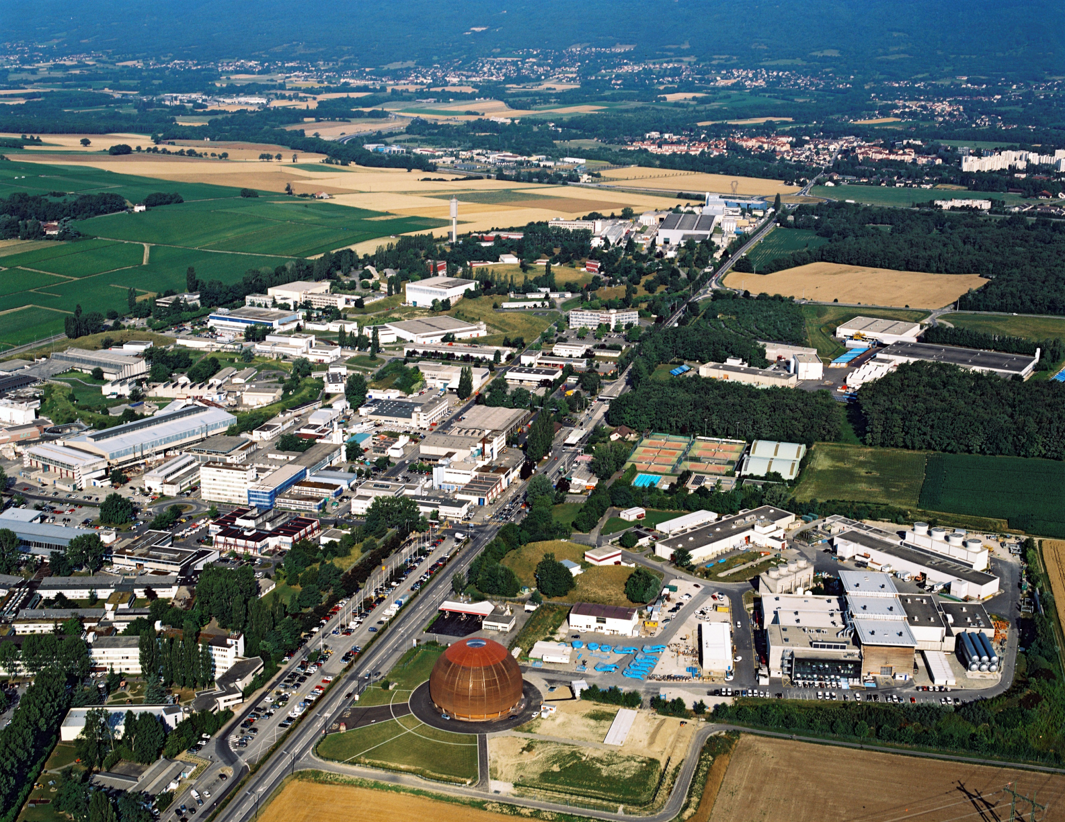
CERN Site & ATLAS
Swiss
French
Border
Original
CERN
Site
ATLAS
Site

Slide 36


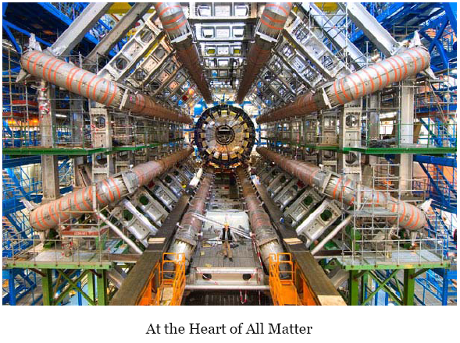
&

Slide 37
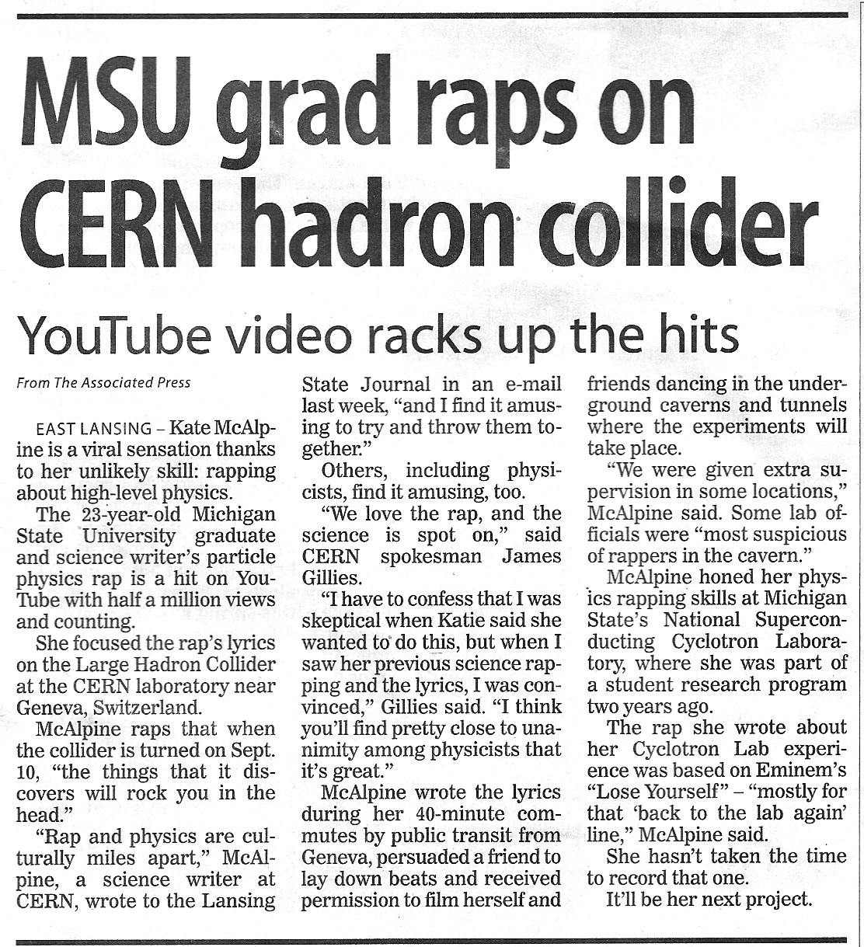
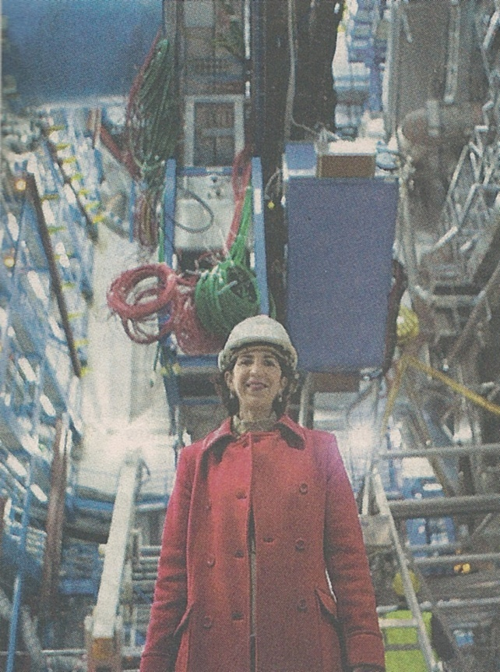
Newspaper Articles & TV Shows
A Giant takes on Big Physics
Questions – New York Times
There’s even a Rap Song
Science Journal – Collider
may reveal origin of mass

Slide 38
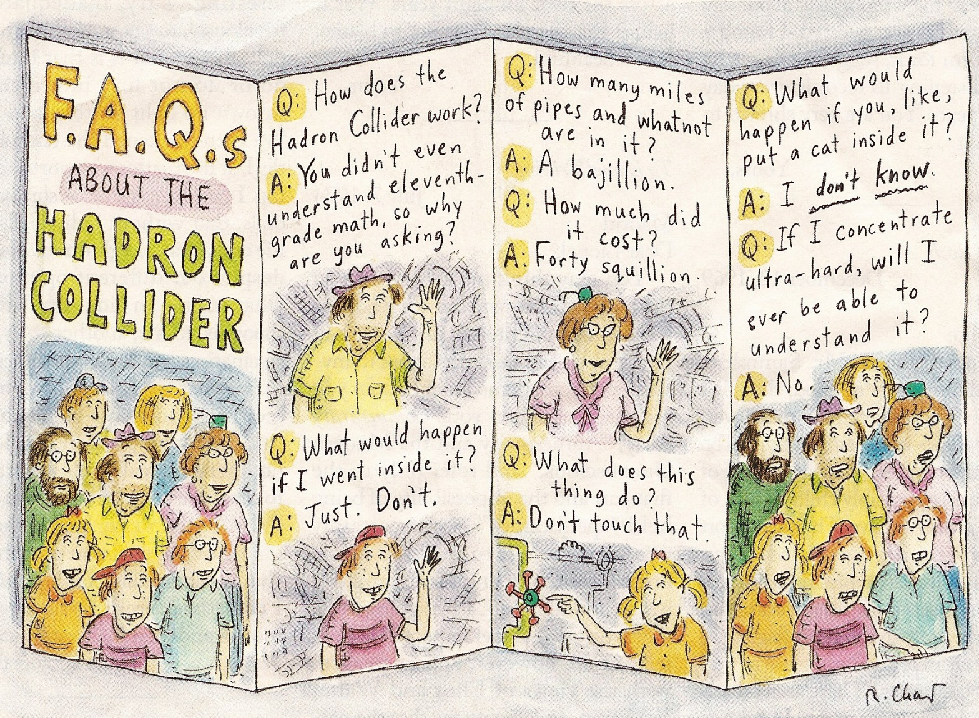
And a New Yorker Cartoon

Slide 39
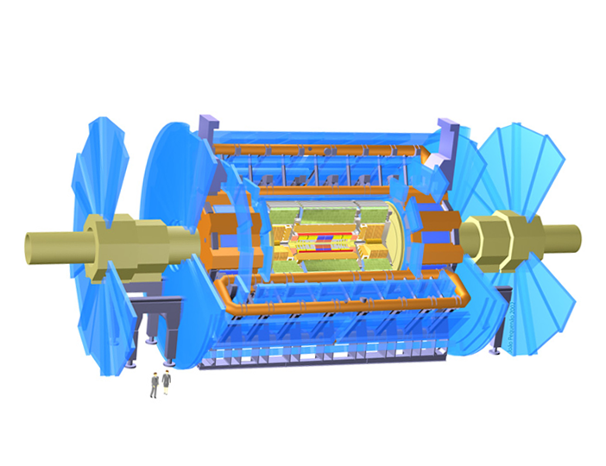
The Components of the Detector
Michigan built
muon chambers
Big Wheel &
Small Wheel
Inner tracking chamber
Solenoid
Protons
Protons
Russian
chambers
Calorimetry
Muon toroids

Slide 40
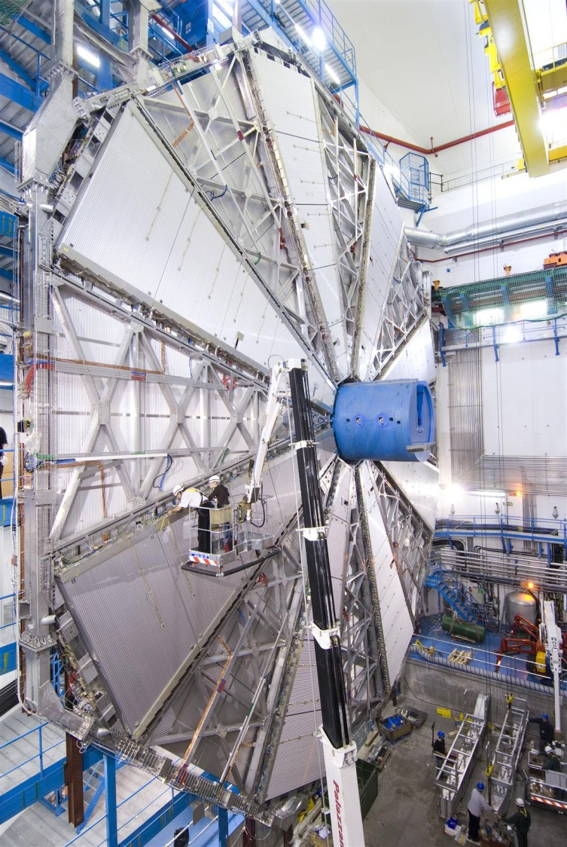
Big Wheel Assembled in Cavern
Michigan
Physicist
Connecting
Electronics
On the Big
Wheel.
~ 100 feet

Slide 41
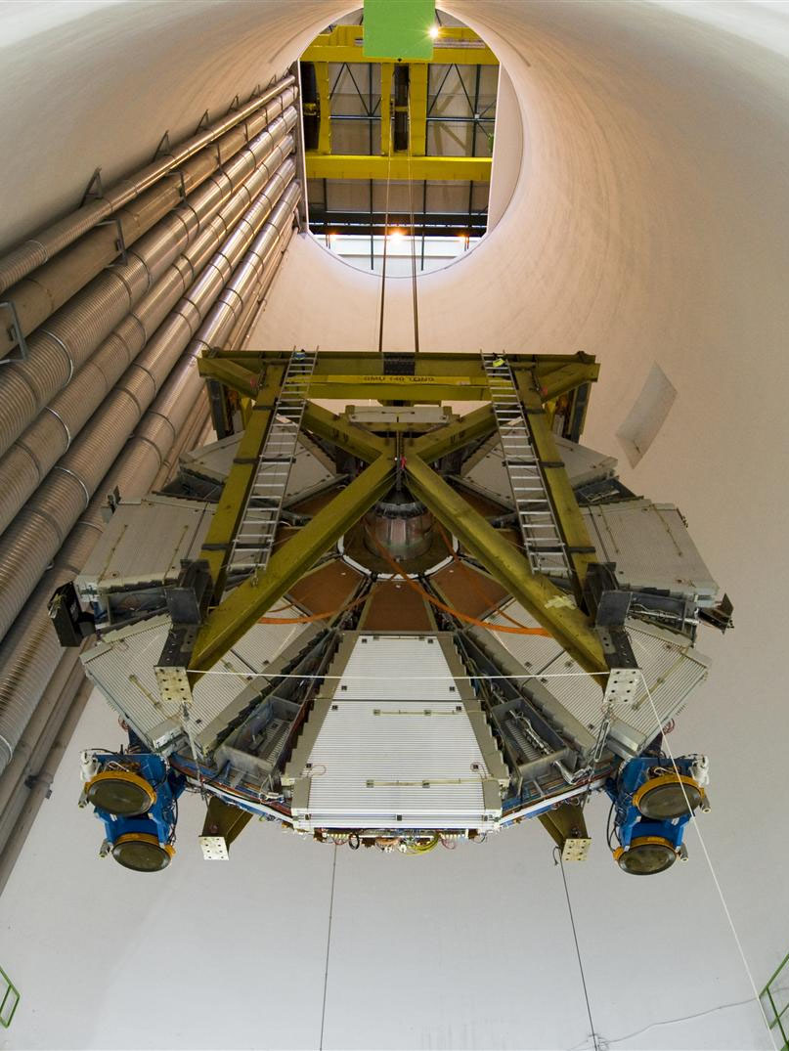
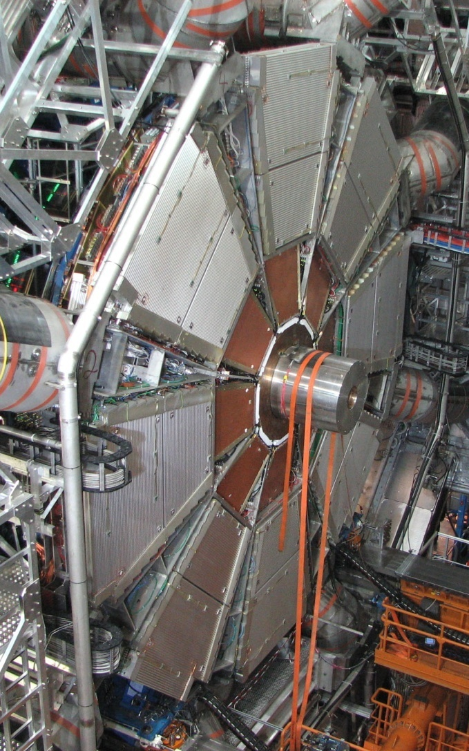
Lower & Position Small Wheel
11 m
The smaller shaft

Slide 42
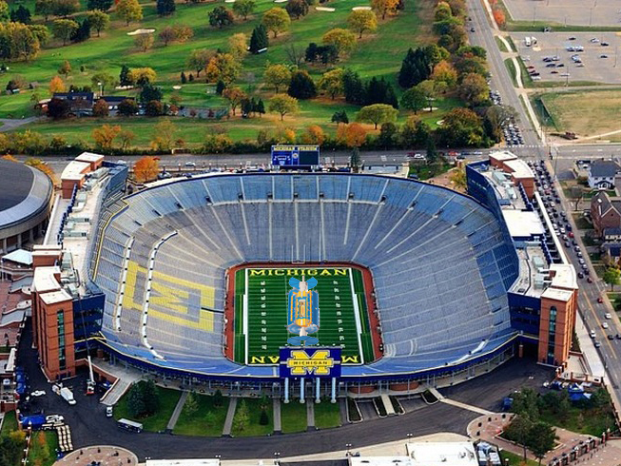
On a Familiar Site

Slide 43
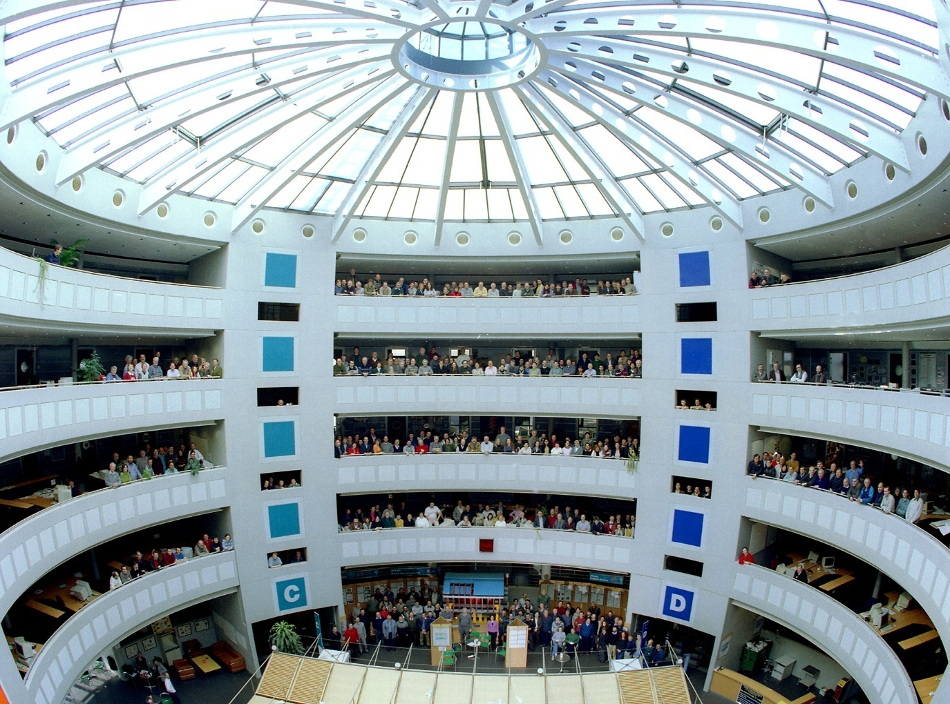
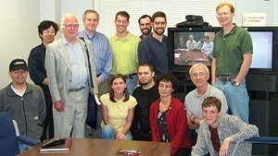
The People in the Hunt
All these people are searching
for the particle proposed by
Peter Higgs and others.
Peter Higgs during a visit to Ann Arbor for an MCTP meeting shown with CDF & ATLAS experimentalist.
Peter Higgs
ATLAS collaboration

Slide 44
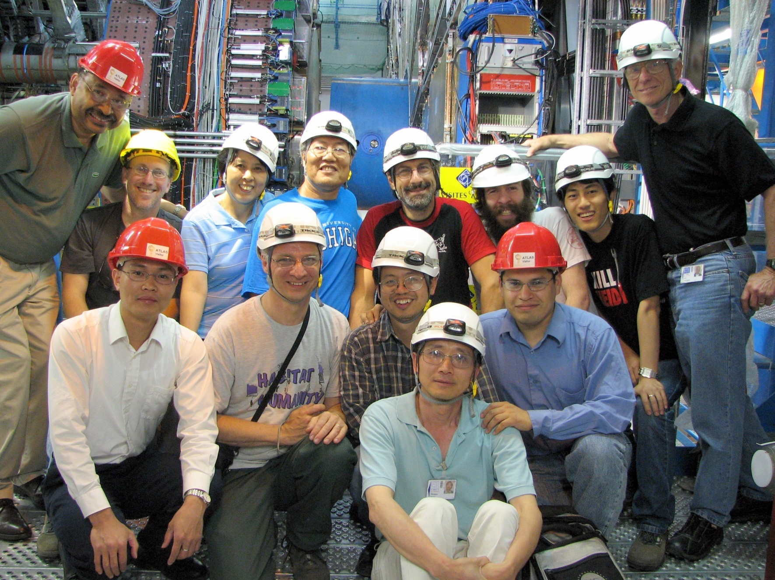
Members of the Michigan Team in the ATLAS Pit (2007)

Slide 45
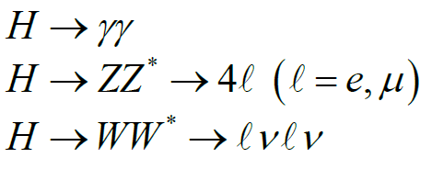
Detection of Higgs Boson in lepton and photon decay channels
Thus, ATLAS needs to measure
γ, e - gamma rays & electrons with good precision
μ – muons with good precision

Slide 46
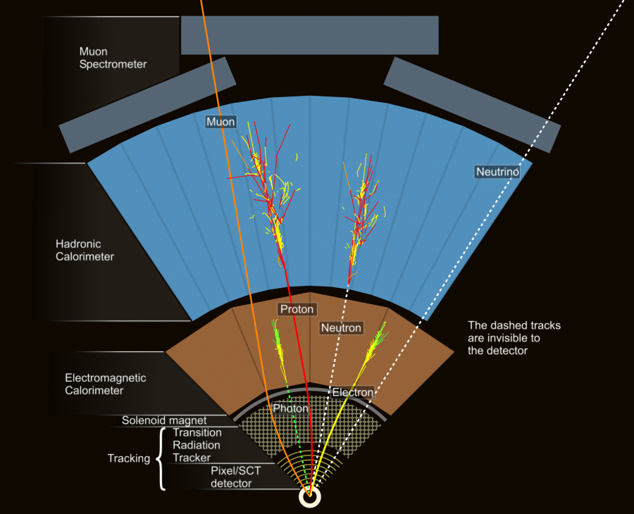
Particle Identification in ATLAS
Muon
Jets
electron, γ
Charged tracks
Interaction
vertices

Slide 47

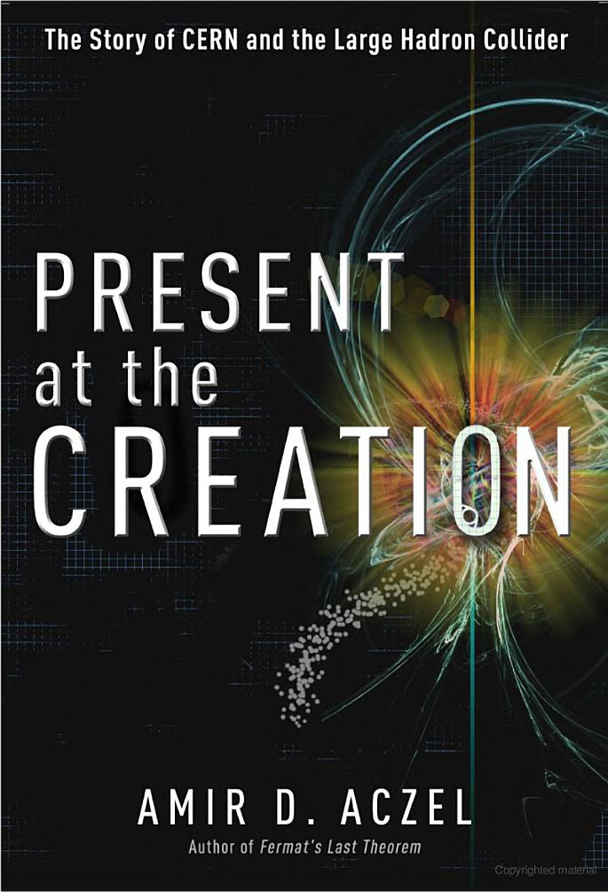
Books for Extended Reading

Slide 48

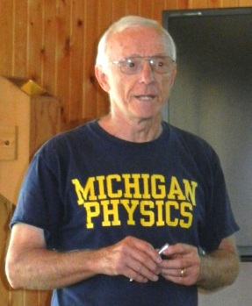
The Announcement
The Announcement was July 4th from CERN & Australia (4AM EST)
I was at Camp Michigania listening with a full moon above Lake Walloon.
Having it all!
Later that day!

Slide 49
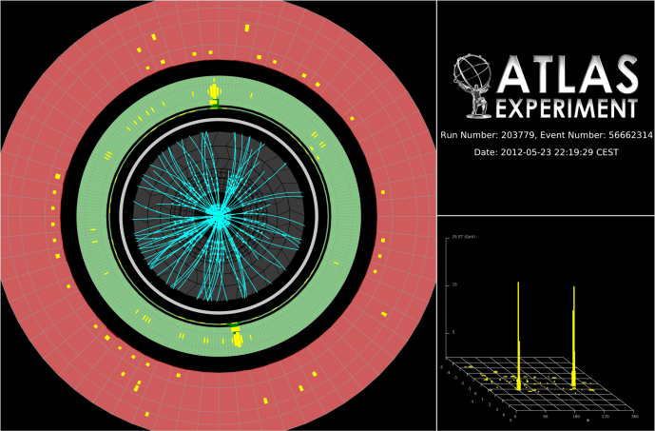
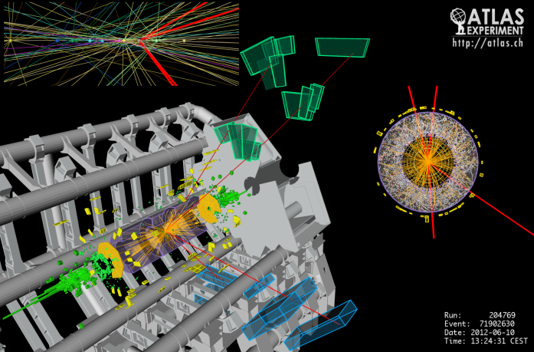
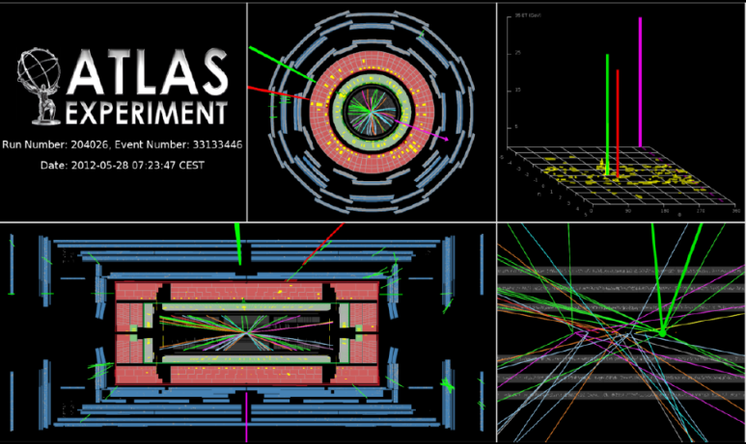
Observation of a Higgs-like Particle at ATLAS
H→ γγ
H→ ZZ*→ μμμμ
H→ WW*→ eνμν
Jianming Qian
Department of Physics, University of Michigan

Slide 50
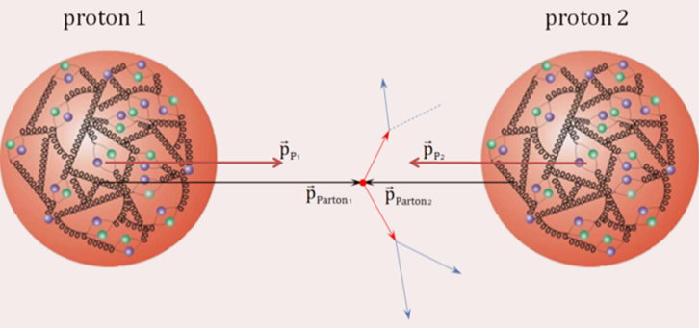

Proton-proton Collision Data
The Large Hadron Collider is a circular proton-proton collider with
a design energy of 14 TeV. It has been in operation since 2010
running at lower energies.
When two protons collide, the actual
collision occurs between quarks and
gluons.
ATLAS detector selects and records “interesting”
collisions for offline reconstruction and analysis.
The results presented today are based on the data
taken in 2011 at 7 TeV and in 2012 (first 6 months)
at 8 TeV.

Slide 51


A Discovery !
CERN seminar (July 4, 2012):
  Planned as an update of the
  search… going out with a bang!
Rolf Heuer (CERN Director General)
  “We have a discovery. We have observed a new particle that is consistent with a Higgs boson.”
Submitted on July 31, 2012
Published: Phys. Lett. B716, 1 (2012)
http://arxiv.org/abs/1207.7214

Slide 52


Higgs Boson Production at LHC
Yukawa
Coupling
“Gauge”
Coupling
Total number of background events
~5×10¹⁴ ⇒ Signal/Background~10⁻¹⁰

Slide 53

Higgs Boson Decay
Higgs boson is expected to
have a lifetime of ~10⁻²² sec
and decays immediately
to (m_{H}=125 GeV)
  bb: 57.7%
  WW: 21.5%
  ττ: 6.3%
  ZZ: 2.6%
  γγ: 0.23%
bb and ττ final states are overwhelmed by backgrounds, clean final
states generally involve leptons (e and μ). Most sensitive channels:

Slide 54



H → γγ Search
Photons are stable particles that can be identified and measured
relative easily ⇒ full reconstruction of the Higgs boson decay.
Select candidate events with two high momentum
photons and reconstruct the mass of the diphoton
system. Categorizing samples to improve sensitivity.
Observe an excess of ~300 events (170 expected at 126 GeV)
⇒ probability of background fluctuation: 2×10⁻⁶ (4.5σ)

Slide 55


H→ZZ*→4l Search
Z bosons have a lifetime of 10⁻²⁵ sec, only
their decay products can be directly detected.
When both Z bosons decay to pairs of electrons or muons:
  very small backgrounds
  full reconstruction of the Higgs boson decay
The Analysis:
  select events with two pairs of
  electrons or muons, reconstruct
  the mass of the 4-lepton system.
The result:
  Between m_{4l}=120-130 GeV:
  Backgrounds: 5.1±0.8 events
  Expected signal: 5.3±0.8 events
  Observed in data: 13 events
Probability of background fluctuation:
3×10⁻⁴ (3.4σ)

Slide 56

A H→ZZ*→4l Candidate

Slide 57


H→WW*→eν μν Search
W bosons are unstable and decay immediately. The cleanest
decay is to a charged lepton and a neutrino.
Neutrinos are weakly interacting particles
and generally escape undetected
  no full reconstruction of the Higgs decay
  large backgrounds
Use “transverse” mass as the
signal-background discriminant:
Categorization of the samples to
improve sensitivity.
Events after all selections:
  Backgrounds: 383±28
  Expected signal: 58±9
  Observed in data: 453
Significant excess, probability of
background fluctuation: 3×10⁻³ (2.8σ)

Slide 58


Combination
All three individual search channels show significant excesses above
background expectations.
When combined, the overall excess has a statistical significance of 5.9σ
(or equivalently a probability of background fluctuation of 1.7×10⁻⁹)
⇒ exceeding the traditional 5σ threshold for a discovery!

Slide 59
Next Steps
We have observed a new particle in the search of the Higgs boson
  Mass: 126.0±0.4(stat)±0.4(syst) GeV
  Rate: 1.4±0.3 times of the rate predicted by the Standard Model
The new particle is consistent with the expectation of the long-
sought Higgs Boson. However more data are needed to ascertain
its identity:
  Observed so far in boson final states (γγ, WW, ZZ), it’s decay to
  fermion final states (bb, ττ, …) needs to be established;
  Its overall production rate appears to be consistent with the
  expectation, but H→γγ rate is considerably higher than expected:
  statistical fluctuation or indication of new physics?
  Measurement of its spin and CP properties; …
We are at a new dawn of particle physics:
  The LHC program is at its infancy. The LHC energy will increase to
  14 TeV in 2015 and the dataset increases by a factor >100;
  New facilities dedicated to study Higgs physics are being proposed…

Slide 60



Aaron Pierce
Theorist
FOUND?
60

Slide 61



Importance of the WW/ZZ Decays
QED
“Scalar QED”
W,Z
h
W,Z
61

Slide 62


62

Slide 63




Gravity is VERY weak
Gravity is very weak:
63

Slide 64


Higgs Production and Decays
Related question: Is it THE Higgs?
64

Slide 65


Production
top quark?
what else?
Decay
Anything else?
65

Slide 66


Superpartners
Standard Model
Super Partners
Identical, but
different “spin”
heavier
66

Slide 67


Supersymmetry Prediction
SUSY Broken
What is
?
67

Slide 68



Living Dangerously in Standard Model?
DeGrassi, et al. 1205.6497
68

Slide 69

Knowing about the Higgs Sharpens Other Predictions
X
X
~
69

Slide 70
Conclusions
We’ve found a Higgs boson.
Is it the Higgs boson?
Why is gravity so weak?
Dark Matter?
Surprises? Energy nearly doubling!
70

Slide 71

Worldwide LHC CPU-hours
x 10⁶
Note: Michigan Tier-2
~ 8 billion CPU hours per year

